Slide 1
2025 KDP Cold Beverage
SOUTHWEST REGION portfolio
Not all flavors or packages available in all areas

Slide 2
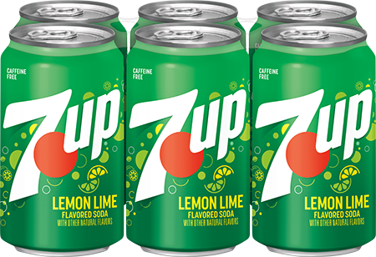
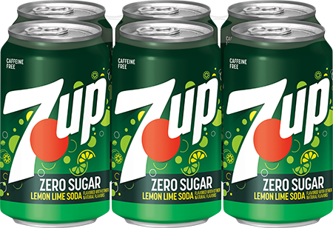
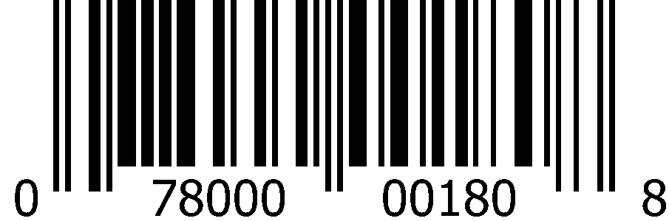
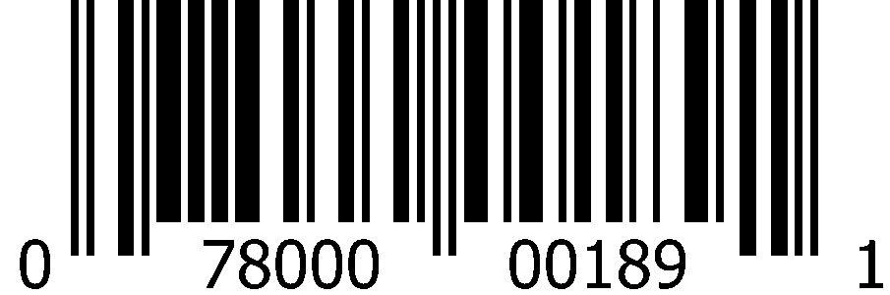
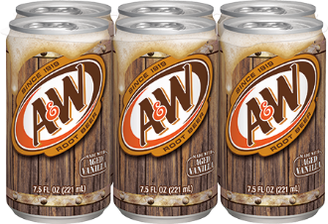
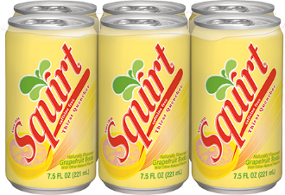
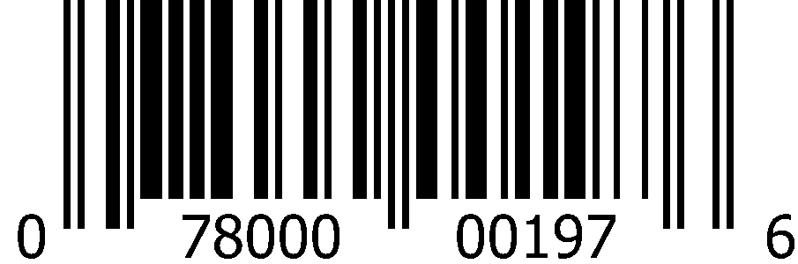
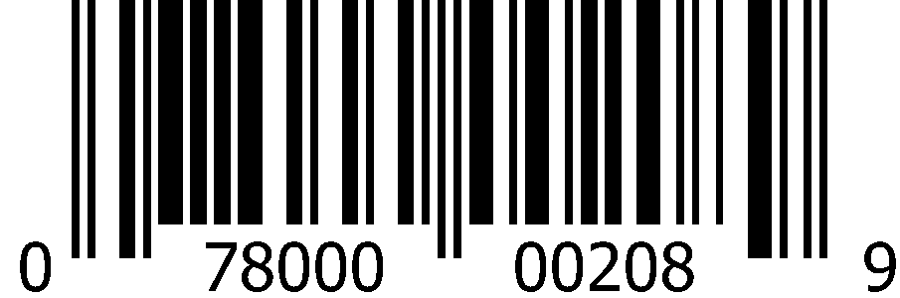
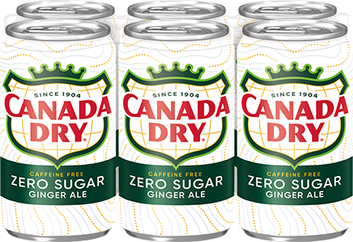
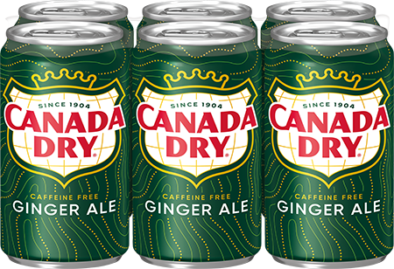
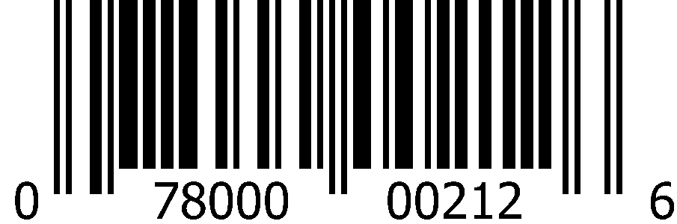
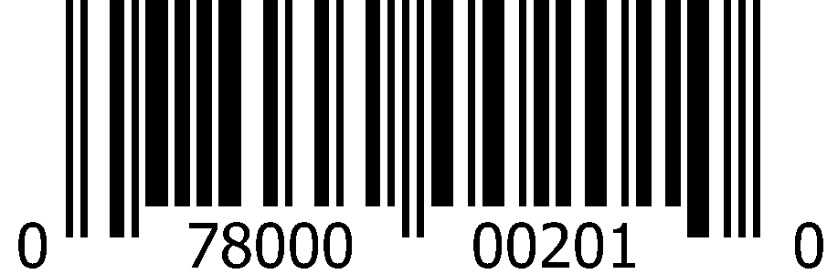
Carbonated Soft Drinks 7.5oz Slim Cans (4x6pk)
 | 7Up |  | 7Up Zero Sugar
 | 1008 5412 |  | 5413
 | 0-78000-00180-8 |  | 0-78000-00189-1
 | A&W Root Beer |  | Squirt
 | 1008 5415 |  | 1008 5424
 | 0-78000-00197-6 |  | 0-78000-00208-9
 | Canada Dry Ginger Ale Zero Sugar |  | Canada Dry Ginger Ale
 | 1008 6588 |  | 1008 5417
 | 0-78000-00212-6 |  | 0-78000-00201-0

Slide 3
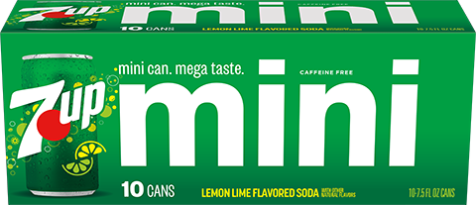
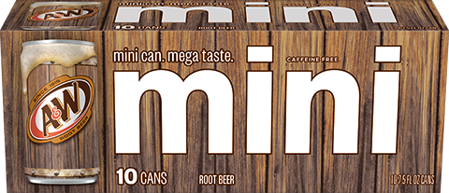
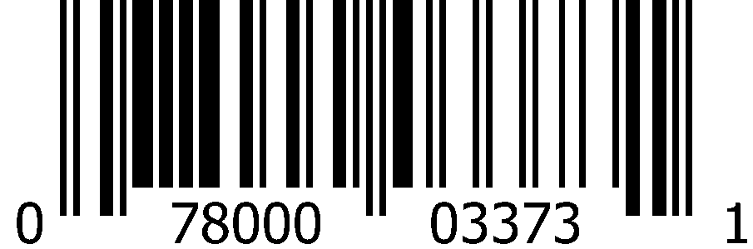
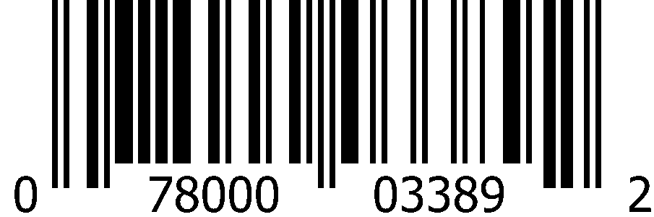
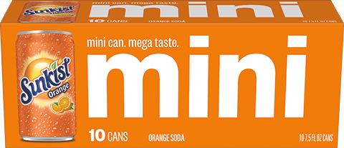
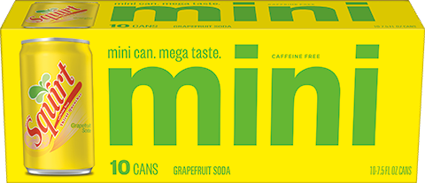
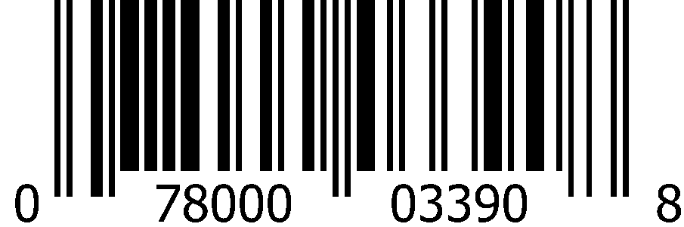
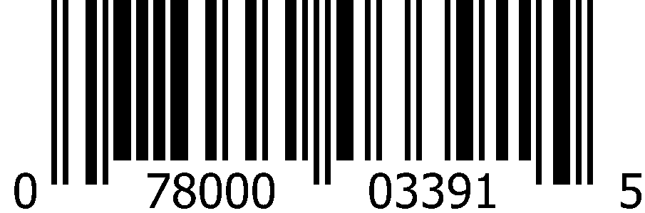
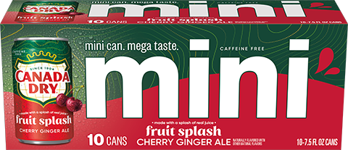
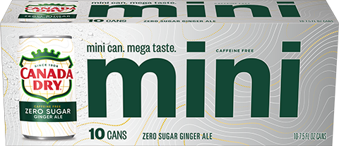
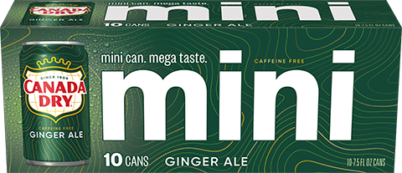
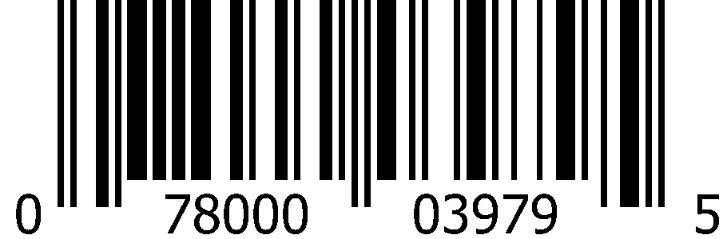

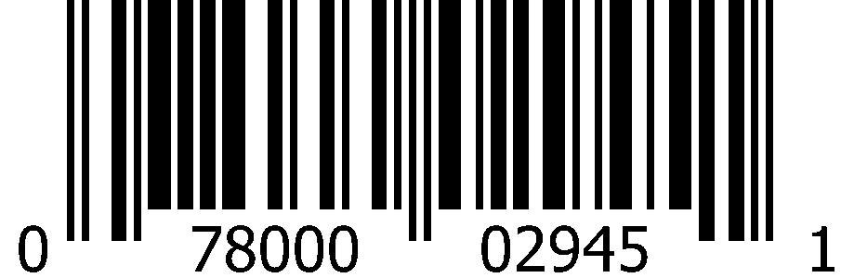
Carbonated Soft Drinks 7.5oz Slim Cans (3x10pk)
 | 7Up |  | A&W Root Beer
 | 1012 8315 |  | 1013 0141
 | 0-78000-03373-1 |  | 0-78000-03389-2
 | Sunkist Orange |  | Squirt
 | 1013 0142 |  | 1013 0144
 | 0-78000-03390-8 |  | 0-78000-03391-5
 | Canada Dry Cherry Ginger Ale |  | Canada Dry Ginger Ale Zero Sugar |  | Canada Dry Ginger Ale
 | 1016 5973 |  | 1013 0140 |  | 1012 8316
 | 0-78000-03979-5 |  | 0-78000-03388-5 |  | 0-78000-02945-1

Slide 4
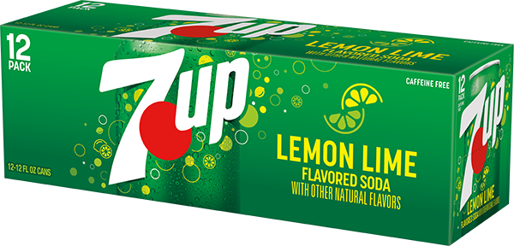
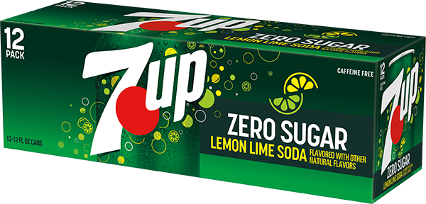
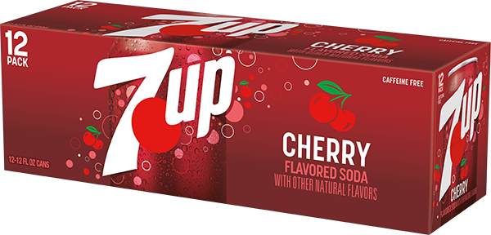
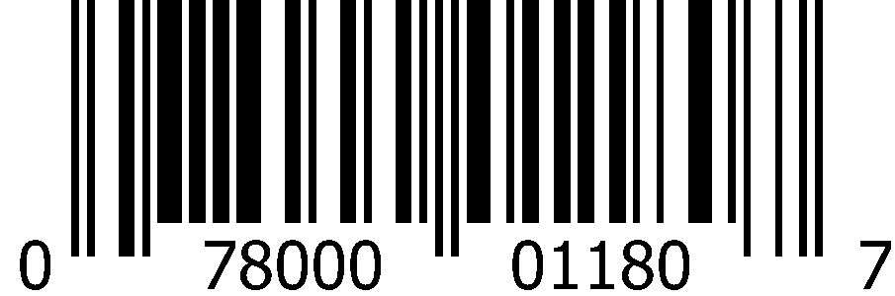
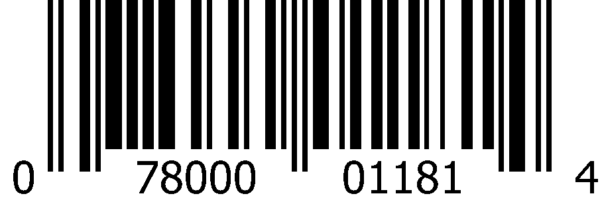
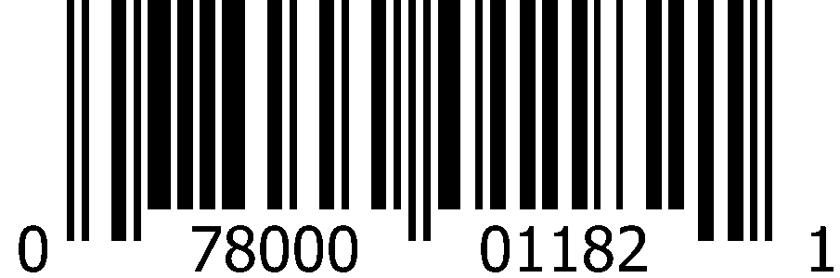
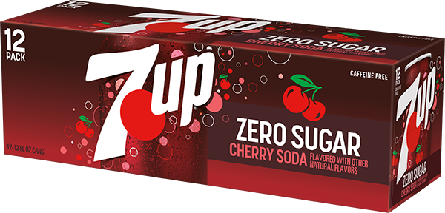
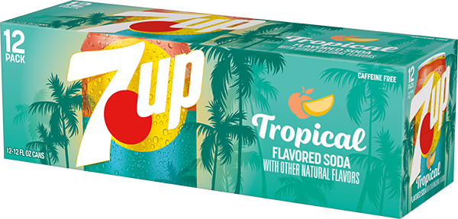
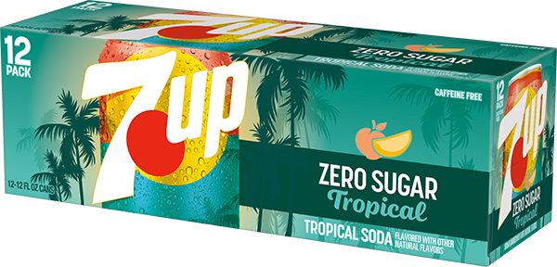
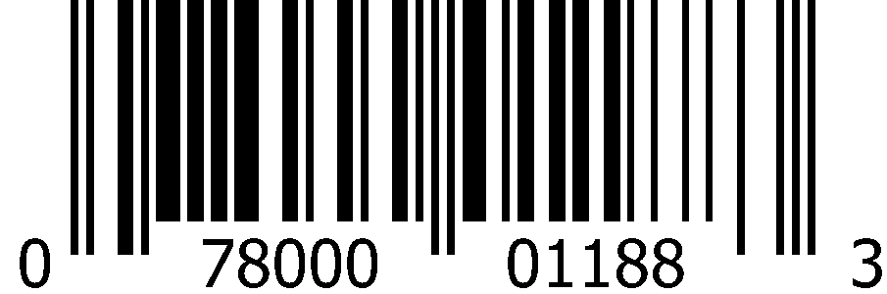
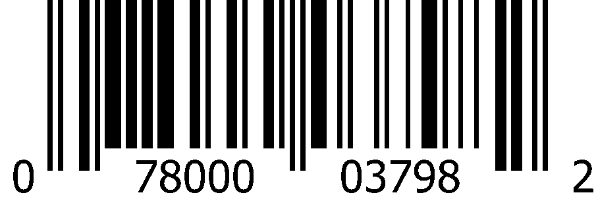
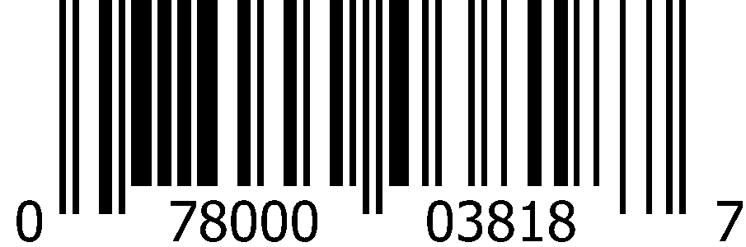
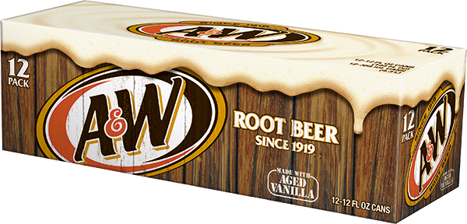
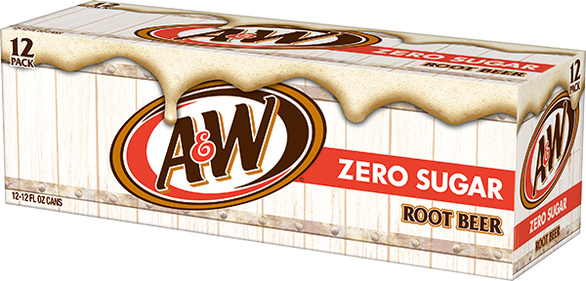
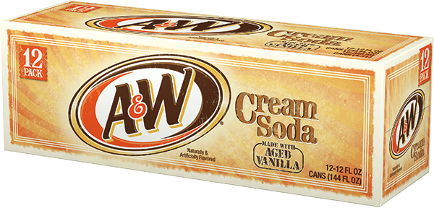
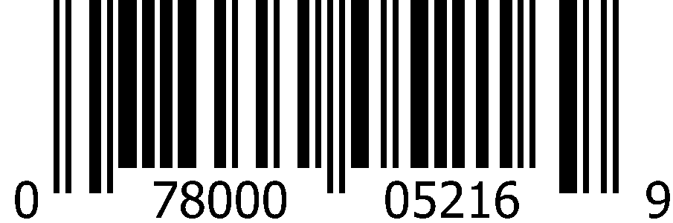
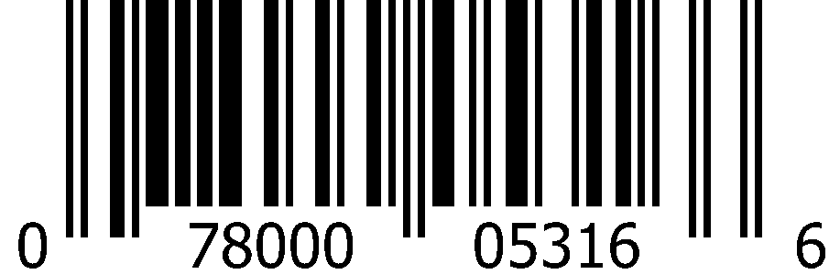
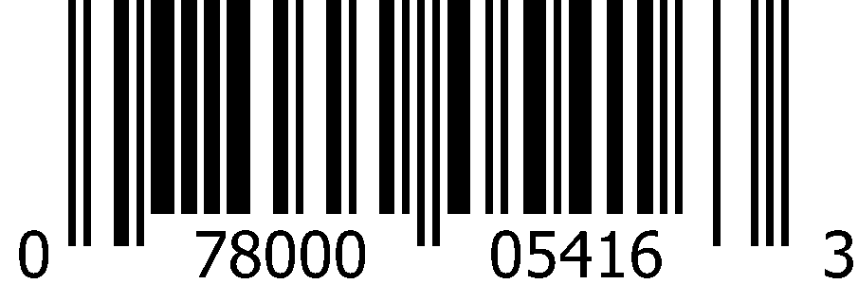
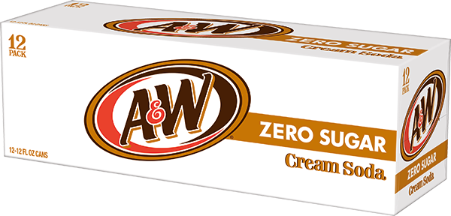
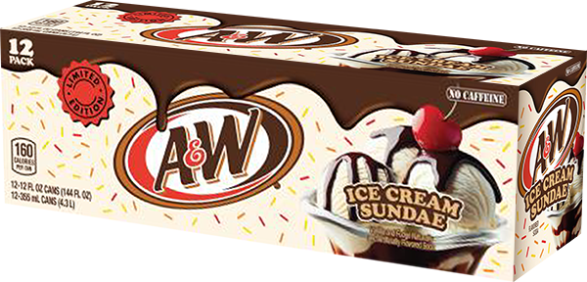
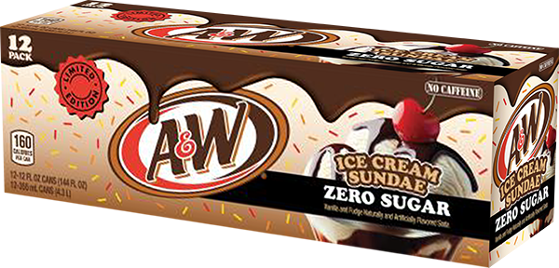
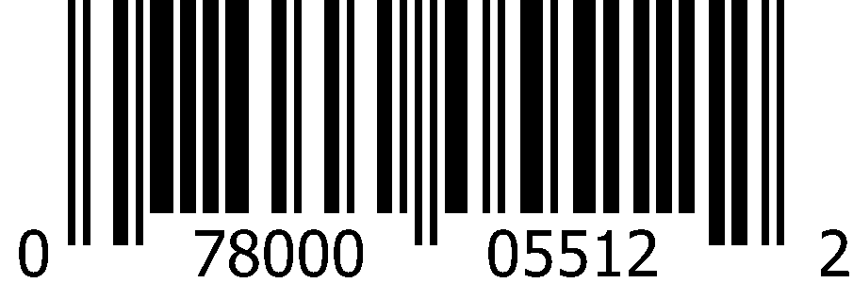
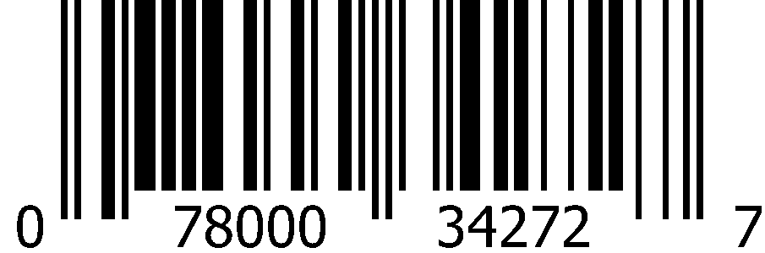

Carbonated Soft Drinks 12oz Cans (2x12pk)
 | 7Up |  | 7Up Zero Sugar |  | Cherry 7Up
 | 1000 0829 Deposit |  | 1000 0830 Deposit |  | 0833
 | 0-78000-01180-7 |  | 0-78000-01181-4 |  | 0-78000-01182-1
 | Cherry 7Up Zero Sugar |  | 7Up Tropical |  | 7Up Tropical Zero Sugar
 | 1000 0834 |  | 6397 |  | 1015 6395
 | 0-78000-01188-3 |  | 0-78000-03798-2 |  | 0-78000-03818-7
 | A&W Root Beer |  | A&W Root Beer Zero Sugar |  | A&W Cream Soda
 | 1000 0852 Deposit |  | 1000 0853 |  | 1000 0831
 | 0-78000-05216-9 |  | 0-78000-05316-6 |  | 0-78000-05416-3
 | A&W Cream Soda Zero Sugar |  | A&W Ice Cream Sundae |  | A&W Ice Cream Sundae Zero Sugar
 | 1000 0832 |  | 1016 4654 |  | 1016 4655
 | 0-78000-05512-2 |  | 0-78000-34272-7 |  | 0-78000-65794-4

Slide 5
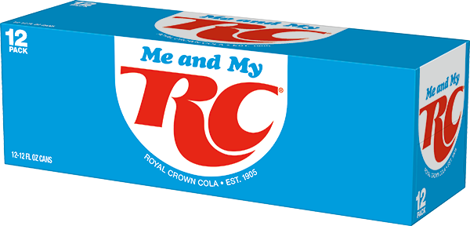
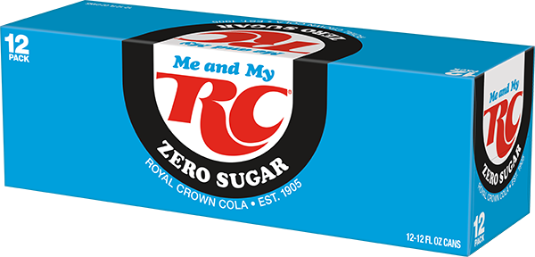
















Carbonated Soft Drinks 12oz Cans (2x12pk)
 | RC Cola |  | RC Cola Zero Sugar |  | Cherry RC Cola
 | 1000 0838 |  | 1016 5232 |  | 1000 0179
 | 0-78000-04116-3 |  | 0-78000-04082-1 |  | 0-78000-04416-4
 | Sunkist Orange |  | Sunkist Orange Zero Sugar
 | 1000 0865 Deposit |  | 1000 0863
 | 0-78000-11316-7 |  | 0-78000-12216-9
 | Sunkist Berry Lemonade |  | Sunkist Strawberry Orange
 | 1013 7157 |  | 1015 8803
 | 0-78000-03555-1 |  | 0-78000-03850-7
 | Big Red |  | Cactus Cooler
 | 1000 0862 |  | 1001 1970
 | 0-71817-03329-1 |  | 0-78000-01162-3

Slide 6


















Carbonated Soft Drinks 12oz Cans (2x12pk)
 | Squirt |  | Squirt Zero Sugar
 | 1000 0187 |  | 1000 0850
 | 0-78000-01616-1 |  | 0-78000-01716-8
 | Vernors Ginger Soda |  | Vernors Ginger Soda Zero Sugar
 | 1000 0840 |  | 1000 0841
 | 0-78000-18016-9 |  | 0-78000-18216-3
 | Canada Dry Cranberry Ginger Ale |  | Canada Dry Fruit Splash Cherry Ginger Ale |  | Canada Dry Cherry Ginger Ale Zero Sugar
 | 1000 1994 |  | 1015 9681 |  | 1015 9680
 | 0-78000-15616-4 |  | 0-78000-03883-5 |  | 0-78000-03886-6
 | Canada Dry Ginger Ale Zero Sugar |  | Canada Dry Ginger Ale
 | 1000 0905 |  | 1000 0904
 | 0-78000-14816-9 |  | 0-78000-15216-6

Slide 7












Carbonated Soft Drinks 12oz Cans (18pk)
 | 7Up |  | Sunkist Orange |  | Big Red
 | 1001 5534 |  | 1001 5439 |  | 1002 1433
 | 0-78000-02002-1 |  | 0-78000-11308-2 |  | 0-71817-80009-1
 | RC Cola |  | RC Cola Zero Sugar |  | Cherry RC Cola
 | 1001 5532 |  | 1016 9105 |  | 1016 4706
 | 0-78000-01484-6 |  | 0-78000-04170-5 |  | 0-78000-03978-8

Slide 8










Carbonated Soft Drinks 12oz Cans (24pk)
 | 7Up |  | A&W Root Beer |  | Sunkist Orange
 | 1000 1071 |  | 1000 0227 |  | 1000 0228
 | 0-78000-01105-0 |  | 0-78000-05213-8 |  | 0-78000-11313-6
 | Squirt |  | Canada Dry Ginger Ale
 | 1000 0051 |  | 1003 6798
 | 0-78000-01613-0 |  | 0-78000-15213-5

Slide 9










Carbonated Soft Drinks 12oz Cans (36pk)
 | 7Up |  | A&W Root Beer |  | Sunkist Orange
 | 1000 1614 |  | 1005 6876 |  | 1000 1617
 | 0-78000-80486-7 |  | 0-78000-80488-1 |  | 0-78000-80489-8
 | Squirt |  | Canada Dry Ginger Ale
 | 1000 2746 |  | 1005 6875
 | 0-78000-80485-0 |  | 0-78000-80490-4

Slide 10














Carbonated Soft Drinks 16oz Cans (24pk)
 | 7Up |  | A&W Root Beer |  | Sunkist Orange
 | 1008 9301 |  | 1008 9269 |  | 1008 6430
 | 0-78000-00039-9 |  | 0-78000-05223-7 |  | 0-78000-11323-5
 | Squirt |  | Canada Dry Ginger Ale
 | 1009 8403 |  | 1008 9257
 | 0-71817-01623-9 |  | 0-78000-02439-5
 | RC Cola |  | RC Berries and Cream
 | 1015 7739 |  | 1014 9170
 | 0-78000-04123-1 |  | 0-78000-03699-2

Slide 11








Carbonated Soft Drinks 12oz Bottles (3x8pk)
 | 7Up |  | A&W Root Beer
 | 1000 2282 |  | 1000 2281
 | 0-78000-01280-4 |  | 0-78000-05288-6
 | Squirt |  | Canada Dry Ginger Ale
 | 1002 8020 |  | 1004 5978
 | 0-78000-01688-8 |  | 0-78000-15288-3

Slide 12


















Carbonated Soft Drinks 16.9oz Bottles (4x6pk)
 | 7Up |  | 7Up Zero Sugar |  | A&W Root Beer
 | 1000 1236 |  | 1000 1237 |  | 1000 1251
 | 0-78000-01219-4 |  | 0-78000-01223-1 |  | 0-78000-05242-8
 | A&W Root Beer Zero Sugar |  | Sunkist Orange |  | Squirt
 | 1000 1252 |  | 1000 1257 |  | 1000 1249
 | 0-78000-05342-5 |  | 0-78000-11342-6 |  | 0-78000-00369-7
 | Squirt Zero Sugar |  | Canada Dry Ginger Ale Zero Sugar |  | Canada Dry Ginger Ale
 | 1000 2165 |  | 1000 2576 |  | 1000 1266
 | 0-78000-00377-2 |  | 0-78000-14842-8 |  | 0-78000-00117-4

Slide 13


















Carbonated Soft Drinks 20oz Bottles (24pk)
 | 7Up |  | 7Up Zero Sugar |  | Cherry 7Up
 | 1000 1108 |  | 1000 1091 |  | 1000 1110
 | 0-78000-00161-7 |  | 0-78000-00162-4 |  | 0-78000-00554-7
 | 7Up Tropical |  | 7Up Tropical Zero Sugar
 | 1015 6396 |  | 1016 5726
 | 0-78000-03795-1 |  | 0-78000-04145-3
 | A&W Root Beer |  | A&W Root Beer Zero Sugar |  | A&W Cream Soda |  | A&W Ice Cream Sundae
 | 1000 1096 |  | 1000 1122 |  | 1000 1109 |  | 1016 2816
 | 0-78000-05240-4 |  | 0-78000-05340-1 |  | 0-78000-05440-8 |  | 0-78000-67980-9

Slide 14






















Carbonated Soft Drinks 20oz Bottles (24pk)
 | RC Cola |  | Diet RC Cola |  | Big Red |  | Cactus Cooler
 | 1000 1111 |  | 1000 0039 |  | 1000 1128 |  | 1001 1968
 | 0-78000-04140-8 |  | 0-78000-04240-5 |  | 0-71817-00037-8 |  | 0-78000-01164-7
 | Sunkist Orange |  | Sunkist Berry Lemonade |  | Sunkist Raspberry Blood Orange
 | 1000 1130 |  | 1013 6557 |  | 1016 4769
 | 0-78000-11340-2 |  | 0-78000-03520-9 |  | 0-78000-39540-2
 | Squirt |  | Ruby Red Squirt |  | Canada Dry Ginger Ale Zero Sugar |  | Canada Dry Ginger Ale
 | 1000 1120 |  | 1000 1127 |  | 1005 7516 |  | 1000 1150
 | 0-78000-01640-6 |  | 0-78000-01840-0 |  | 0-78000-14840-4 |  | 0-78000-15240-1

Slide 15




Carbonated Soft Drinks 1L Bottles (15pk)
 | Squirt |  | Canada Dry Ginger Ale
 | 1000 1322 |  | 1000 1335
 | 0-78000-01645-1 |  | 0-78000-15245-6

Slide 16








Carbonated Soft Drinks 1.25L Bottles (12pk)
 | 7Up |  | A&W Root Beer
 | 1010 7491 |  | 1010 7490
 | 0-78000-02659-7 |  | 0-78000-02657-3
 | Squirt |  | Canada Dry Ginger Ale
 | 1010 7461 |  | 1010 7539
 | 0-78000-03069-3 |  | 0-78000-01154-8

Slide 17














Carbonated Soft Drinks 2L Bottles (8pk)
 | 7Up |  | 7Up Zero Sugar
 | 1000 1415 |  | 1000 1416
 | 0-78000-00034-4 |  | 0-78000-00075-7
 | Cherry 7Up |  | Cherry 7Up Zero Sugar
 | 1000 1419 |  | 1000 1420
 | 0-78000-00531-8 |  | 0-78000-00831-9
 | A&W Root Beer |  | A&W Root Beer Zero Sugar |  | A&W Cream Soda
 | 1000 1437 |  | 1000 1438 |  | 1000 1417
 | 0-78000-05246-6 |  | 0-78000-05346-3 |  | 0-78000-05446-0

Slide 18


















Carbonated Soft Drinks 2L Bottles (8pk)
 | RC Cola |  | RC Cola Zero Sugar |  | Cherry RC Cola
 | 1000 1424 |  | 1016 5424 |  | 1000 1606
 | 0-78000-00337-6 |  | 0-78000-04112-5 |  | 0-78000-04446-1
 | Sunkist Orange |  | Sunkist Orange Zero Sugar |  | Sunkist Berry Lemonade
 | 1000 1455 |  | 1000 1454 |  | 1013 7158
 | 0-78000-11346-4 |  | 0-78000-12246-6 |  | 0-78000-03554-4
 | Big Red |  | Cactus Cooler |  | Canada Dry Original
 | 1000 1453 |  | 1001 1973 |  | 1000 1486
 | 0-71817-00021-7 |  | 0-78000-01169-2 |  | 0-78000-14746-9

Slide 19
















Carbonated Soft Drinks 2L Bottles (8pk)
 | Squirt |  | Squirt Zero Sugar |  | Ruby Red Squirt
 | 1000 1435 |  | 1000 1436 |  | 1000 0096
 | 0-78000-01646-8 |  | 0-78000-01746-5 |  | 0-78000-01846-2
 | Vernors Ginger Soda |  | Canada Dry Cranberry Ginger Ale |  | Canada Dry Fruit Splash Cherry Ginger Ale
 | 1000 0098 |  | 1000 1595 |  | 1016 5904
 | 0-78000-18046-6 |  | 0-78000-15646-1 |  | 0-78000-03940-5
 | Canada Dry Ginger Ale Zero Sugar |  | Canada Dry Ginger Ale
 | 1000 1488 |  | 1000 1487
 | 0-78000-14846-6 |  | 0-78000-15246-3

Slide 20




Carbonated Soft Drinks Premium Glass
355mL Mexican Glass (12pk)
 | 7Up |  | Squirt
 | 2002 6451 |  | 2002 6453
 | 0-78000-01954-4 |  | 0-78000-01952-0

Slide 21


















CSD Bag-In-A-Box Fountain Syrup (5 gallon)
 | Dr Pepper |  | 7Up |  | Sunkist Orange |  | Squirt
 | 1000 0703 |  | 1000 0701 |  | 1000 00715 |  | 1000 0708
 | 0-54900-71054-5 |  | 0-78000-20001-0 |  | 0-88500-90111-9 |  | 0-88500-90137-9
 | RC Cola |  | RC Cola Zero Sugar |  | Cherry RC Cola
 | 1000 0705 |  | 1000 0299 |  | 1016 8200
 | 0-88500-90226-0 |  | 0-88500-90229-1 |  | 0-88500-90331-1
 | Big Red |  | Hires Root Beer |  | Tahitian Treat Pink Lemonade
 | 1000 0714 |  | 1004 5980 |  | 1000 0310
 | 0-71817-00055-2 |  | 0-88500-90134-8 |  | 0-88500-90115-7

Slide 22










CSD Bag-In-A-Box Fountain Syrup (2.5 gallon)
 | Dr Pepper Zero Sugar |  | Dr Pepper Cream Soda
 | 1014 9121 |  | 1015 9685
 | 0-54900-00116-2 |  | 0-54900-00152-0
 | Canada Dry Ginger Ale |  | Canada Dry Tonic Water |  | Hawaiian Punch Lemonade
 | 1006 6318 |  | 1000 0330 |  | 1008 8270
 | 0-88500-90125-6 |  | 0-88500-90177-5 |  | 0-88500-00118-5

Slide 23










Canada Dry Mixers
1L Bottles (15pk)
 | Tonic Water |  | Tonic Water Zero Sugar |  | Club Soda
 | 1000 0071 |  | 1000 1334 |  | 1000 1336
 | 0-78000-15345-3 |  | 0-78000-14945-6 |  | 0-78000-14645-5
12oz Cans (4x6pk)
 | Tonic Water |  | Club Soda
 | 1000 0808 |  | 1000 0810
 | 0-78000-00124-2 |  | 0-78000-00122-8

Slide 24









Canada Dry Mixers
7.5oz Slim Cans (4x6pk)
 | Tonic Water |  | Tonic Water Zero Sugar |  | Club Soda
 | 1016 0714 |  | 1016 0704 |  | 1016 0712
 | 0-78000-00224-9 |  | 0-78000-00225-6 |  | 0-78000-00223-2
10oz PET Bellyband Bottles (4x6pk)
 | Club Soda |  | Tonic Water
 | 1011 4955 |  | 1011 4958
 | 0-78000-00341-3 |  | 0-78000-00365-9
 | Ginger Ale
 | 1011 4954
 | 0-78000-00364-2

Slide 25


















Polar Sparkling Seltzer 12oz Cans (3x8pk)
 | Black Cherry |  | Cranberry Lime |  | Lime
 | 1013 8355 |  | 1013 8361 |  | 1013 8365
 | 0-71537-00366-6 |  | 0-71537-00364-2 |  | 0-71537-00367-3
 | Original |  | Orange Vanilla |  | Raspberry Lime
 | 1013 8360 |  | 1015 2004 |  | 1013 8362
 | 0-71537-00365-9 |  | 0-71537-30161-8 |  | 0-71537-00363-5
 | Ruby Red Grapefruit |  | Cranberry Clementine |  | Georgia Peach
 | 1013 8357 |  | 1016 8496 |  | 1016 8495
 | 0-71537-00368-0 |  | 0-71537-30383-4 |  | 0-71537-30338-4

Slide 26










Polar Sparkling Seltzer 12oz Cans (3x8pk)
 | Blackberry Mango |  | Strawberry Watermelon |  | Ginger Lime Mule
 | 1016 0447 |  | 1015 5919 |  | 1015 2006
 | 0-71537-30382-7 |  | 0-71537-30389-6 |  | 0-71537-00326-0
 | Pink Apple & Lemon |  | Nectarine Lemon
 | 1014 9358 |  | 1015 7494
 | 0-71537-00374-1 |  | 0-71537-30378-0

Slide 27










Polar Sparkling Seltzer 20oz Bottles (24pk)
 | Black Cherry |  | Lemon |  | Ruby Red Grapefruit
 | 1013 8421 |  | 1013 8424 |  | 1013 8422
 | 0-71537-06028-7 |  | 0-71537-06034-8 |  | 0-71537-06025-6
 | Lime |  | Original
 | 1016 9240 |  | 1016 9239
 | 0-71537-06035-5 |  | 0-71537-06020-1

Slide 28










Polar Sparkling Seltzer 1L Bottles (12pk)
 | Raspberry Lime |  | Lime |  | Black Cherry
 | 1013 8390 |  | 1013 8406 |  | 1013 8391
 | 0-71537-02030-4 |  | 0-71537-02035-9 |  | 0-71537-02028-1
 | Original |  | Mandarin
 | 1013 8414 |  | 1013 8407
 | 0-71537-02020-5 |  | 0-71537-02044-1

Slide 29






















Bai 18oz Bottles (12pk)
 | Molokai Coconut |  | Puna Coconut Pineapple |  | Shala Coconut Strawberry
 | 1015 9894 |  | 1015 9895 |  | 1016 4534
 | 8-13694-02671-9 |  | 8-13694-02673-3 |  | 8-13694-02719-8
 | Brasilia Blueberry |  | Kula Watermelon |  | Kupang Strawberry Kiwi |  | Zambia Bing Cherry
 | 1015 9908 |  | 1015 9909 |  | 1016 0135 |  | 1015 9911
 | 8-13694-02665-8 |  | 8-13694-02669-6 |  | 8-13694-02690-0 |  | 8-13694-02667-2
 | Costa Rica Clementine |  | Simbu Strawberry |  | Rubi Raspberry Lemon Lime |  | São Paulo Strawberry Lemonade
 | 1016 0136 |  | 1016 2805 |  | 1015 9305 |  | 1016 0140
 | 8-13694-02688-7 |  | 8-13694-02714-3 |  | 8-13694-02639-9 |  | 8-13694-02693-1

Slide 30














Bai 14oz Bottles (4x6pk)
 | Molokai Coconut |  | Puna Coconut Pineapple
 | 1015 9732 |  | 1015 9735
 | 8-13694-02656-6 |  | 8-13694-02657-3
 | Brasilia Blueberry |  | Kula Watermelon |  | Zambia Bing Cherry
 | 1015 9734 |  | 1015 9731 |  | 1015 9733
 | 8-13694-02653-5 |  | 8-13694-02655-9 |  | 8-13694-02654-2
 | Simbu Strawberry |  | Rubi Raspberry Lemon Lime
 | 1016 2806 |  | 1015 9303
 | 8-13694-02717-4 |  | 8-13694-02642-9

Slide 31






Snapple 8oz Bottles (2x8pk)
 | Peach Tea
 | 1015 9535
 | 0-76183-00923-9
 | Kiwi Strawberry |  | Snapple Apple
 | 1015 8700 |  | 1015 8699
 | 0-76183-00909-3 |  | 0-76183-00911-6

Slide 32




















Snapple 16oz Bottles (12pk)
 | Lemon Tea |  | Peach Tea |  | Zero Sugar Peach Tea
 | 1017 3872 |  | 1013 6509 |  | 1013 6532
 | 0-76183-00315-2 |  | 0-76183-00311-4 |  | 0-76183-00314-5
 | Kiwi Strawberry |  | Mango Madness |  | Fruit Punch |  | Snapple Apple
 | 1013 6515 |  | 1013 6517 |  | 1013 6514 |  | 1013 6538
 | 0-76183-00310-7 |  | 0-76183-00312-1 |  | 0-76183-00313-8 |  | 0-76183-00328-2
 | Peach Tea & Lemonade |  | Pink Lemonade |  | Watermelon Lemonade
 | 1016 4997 |  | 1013 6576 |  | 1013 6470
 | 0-76183-47550-8 |  | 0-76183-00329-9 |  | 0-76183-45512-8

Slide 33


















Snapple 16oz Bottles (4x6pk)
 | Lemon Tea |  | Zero Sugar Lemon Tea |  | Peach Tea
 | 1017 3811 |  | 1017 3868 |  | 1013 7150
 | 0-76183-00764-8 |  | 0-76183-00804-1 |  | 0-76183-00766-2
 | Zero Sugar Peach Tea |  | Zero Sugar Raspberry Tea |  | Peach Tea & Lemonade
 | 1013 7149 |  | 1013 6570 |  | 1016 4999
 | 0-76183-00774-7 |  | 0-76183-00817-1 |  | 0-76183-47554-6
 | Zero Sugar Half ‘n Half Lemonade Iced Tea |  | Kiwi Strawberry |  | Snapple Apple
 | 1013 6475 |  | 1013 7148 |  | 1013 7145
 | 0-76183-00798-3 |  | 0-76183-00777-8 |  | 0-76183-00771-6

Slide 34














Snapple 32oz Bottles (12pk)
 | Peach Tea |  | Zero Sugar Peach Tea |  | Pink Lemonade
 | 1000 3023 |  | 1000 3024 |  | 1016 4794
 | 0-76183-32356-4 |  | 0-76183-32357-1 |  | 0-76183-08795-4
 | Kiwi Strawberry |  | Mango Madness |  | Fruit Punch |  | Snapple Apple
 | 1000 3025 |  | 1000 3037 |  | 1000 3038 |  | 1008 8249
 | 0-76183-32363-2 |  | 0-76183-32364-9 |  | 0-76183-32372-4 |  | 0-76183-32850-7

Slide 35








Snapple 64oz Bottles (8pk)
 | Peach Tea |  | Zero Sugar Peach Tea
 | 1000 2904 |  | 1000 2905
 | 0-76183-64356-3 |  | 0-76183-64357-0
 | Kiwi Strawberry |  | Snapple Apple
 | 1000 2906 |  | 1008 8248
 | 0-76183-64363-1 |  | 0-76183-64387-7

Slide 36
















Calypso Lemonade 16oz Glass Bottles (12pk)
 | Ocean Blue Lemonade |  | Strawberry Lemonade |  | Southern Peach Lemonade
 | 2003 8155 |  | 2003 8151 |  | 2003 8150
 | 0-79581-18401-0 |  | 0-79581-18402-7 |  | 0-79581-18403-4
 | Island Wave Lemonade |  | Original Lemonade |  | Paradise Punch Lemonade
 | 2003 8156 |  | 2003 8153 |  | 2003 8152
 | 0-79581-18405-8 |  | 0-79581-18400-3 |  | 0-79581-18404-1
 | Triple Melon Lemonade |  | Zero Sugar Strawberry Lemonade
 | 2003 8163 |  | 2003 8154
 | 0-79581-18407-2 |  | 0-79581-18803-2

Slide 37










Yoo-hoo / Clamato
 | Chocolate 15.5oz Glass (24pk)
 | 1000 6323
 | 0-72350-00011-5
 | Original 16oz Glass (12pk) |  | Picante 16oz Glass (12pk)
 | 1001 1917 |  | 1001 1916
 | 0-14800-51175-8 |  | 0-14800-51274-8
 | Original 32oz PET (12pk) |  | Picante 32oz PET (12pk)
 | 1001 1920 |  | 1001 1923
 | 0-14800-51324-0 |  | 0-14800-51275-5

Slide 38






















La Colombe Cold Brew Draft Latte 11oz Cans (12pk)
 | Triple Draft Latte |  | Vanilla Draft Latte |  | Oatmilk Vanilla Draft Latte
 | 2003 5333 |  | 2003 5332 |  | 2003 5325
 | 6-04913-00488-1 |  | 6-04913-00490-4 |  | 6-04913-00520-8
 | Mocha Draft Latte |  | Caramel Draft Latte |  | Double Draft Latte |  | Black Cold Brew
 | 2003 5334 |  | 2003 5767 |  | 2003 5765 |  | 2003 5763
 | 6-04913-00489-8 |  | 6-04913-00491-1 |  | 6-04913-00530-7 |  | 6-04913-00534-5
 | Strawberry Mocha Draft Latte |  | S’mores Latte Draft Latte |  | Pumpkin Spice Draft Latte |  | Peppermint Mocha Draft Latte
 | 2003 9270 |  | 2003 9269 |  | 2003 6698 |  | 2003 6696
 | 6-04913-00562-8 |  | 6-04913-00557-4 |  | 6-04913-00542-0 |  | 6-04913-00541-3

Slide 39


















La Colombe Cold Brew Draft Latte 9oz Cans (4x4pk)
 | Vanilla Draft Latte |  | Triple Draft Latte |  | Mocha Draft Latte
 | 2003 5324 |  | 5323 |  | 2003 5326
 | 6-04913-00015-9 |  | 6-04913-00016-6 |  | 6-04913-00014-2
 | Oatmilk Vanilla Draft Latte |  | Caramel Draft Latte |  | Strawberry Mocha Draft Latte
 | 2003 5330 |  | 5764 |  | 2003 9339
 | 6-04913-00268-9 |  | 6-04913-00094-4 |  | 6-04913-00566-6
 | S’mores Latte Draft Latte |  | Pumpkin Spice Draft Latte |  | Peppermint Mocha Draft Latte
 | 2003 9337 |  | 2003 7221 |  | 2003 7222
 | 6-04913-00561-1 |  | 6-04913-00041-8 |  | 6-04913-00044-9

Slide 40
























C4 Performance Energy 16oz Cans (12pk)
 | Frozen Bombsicle |  | Strawberry Blast |  | Cosmic Rainbow |  | Sour Gummy Splash
 | 2003 4426 |  | 2003 4425 |  | 2003 4450 |  | 1017 0100
 | 8-42595-10659-6 |  | 8-42595-12175-9 |  | 8-42595-12176-6 |  | 8-42595-13605-0
 | Popsicle Grape |  | Popsicle Cherry |  | Creamsicle |  | Popsicle Hawaiian Pineapple
 | 2003 5281 |  | 2003 5283 |  | 2003 5742 |  | 2003 5284
 | 8-42595-13127-7 |  | 8-42595-13125-3 |  | 8-42595-13162-8 |  | 8-42595-13129-1
 | Jolly Rancher Green Apple |  | Jolly Rancher Watermelon |  | Jolly Rancher Blue Raspberry |  | Hawaiian Punch Fruit Juicy Red
 | 2003 5742 |  | 2003 4425 |  | 2003 4450 |  | 2003 7607
 | 8-42595-13497-1 |  | 8-42595-13496-4 |  | 8-42595-13495-7 |  | 8-42595-13360-8

Slide 41












C4 Performance Energy
16oz Cans (12pk)
 | Orange Slice |  | Strawberry Watermelon Ice
 | 2003 4441 |  | 2003 4435
 | 8-42595-10936-8 |  | 8-42595-10657-2
12oz Cans (6x4pk)
 | Frozen Bombsicle |  | Strawberry Blast |  | Popsicle Cherry
 | 2003 4424 |  | 2003 4415 |  | 2003 5285
 | 8-42595-11304-4 |  | 8-42595-12784-3 |  | 8-42595-13144-4
Variety Pack 12oz Cans (12pk)
 | Popsicle Variety Pack
 | 2003 5287
 | 8-42595-13297-7

Slide 42




















C4 Ultimate Energy 16oz Cans (12pk)
 | Arctic Snow Cone |  | Fruit Punch |  | Electric Sour Apple |  | Atomic Grape
 | 2003 4437 |  | 2003 4440 |  | 1017 0158 |  | 1017 0162
 | 8-42595-10661-9 |  | 8-42595-12165-0 |  | 8-42595-13172-7 |  | 8-42595-13174-1
 | Berry Powerbomb |  | Ruthless Raspberry |  | Nectarine Guava Knockout
 | 2003 5274 |  | 2003 5278 |  | 1016 8531
 | 8-42595-12959-5 |  | 8-42595-12960-1 |  | 8-42595-13171-0
 | Frost Bitten Citrus |  | Tropical Tundra Frost |  | Cherry Bomb Frost
 | 1017 0160 |  | 1017 0161 |  | 1017 0159
 | 8-42595-13553-4 |  | 8-42595-13555-8 |  | 8-42595-13554-1

Slide 43










C4 Smart Energy 12oz Cans (12pk)
 | Strawberry Guava |  | Peach Mango |  | Cherry Berry Lime
 | 2003 4412 |  | 2003 4420 |  | 2003 4413
 | 8-42595-12692-1 |  | 8-42595-11708-0 |  | 8-42595-11983-1
 | Blood Orange Yuzu |  | Watermelon Burst
 | 2003 4410 |  | 2003 4448
 | 8-42595-12690-7 |  | 8-42595-12509-2

Slide 44






C4 Smart Energy 12oz Cans (12pk)
 | Cherry Berry Lime |  | Strawberry Guava |  | Peach Mango
 | 2003 4413 |  | 2003 4412 |  | 2003 4420
 | 8-42595-11983-1 |  | 8-42595-12692-1 |  | 8-42595-11708-0
 | Watermelon Burst |  | Tropical Passionfruit
 | 2003 4448 |  | 2003 4416
 | 8-42595-12509-2 |  | 8-42595-12686-0

Slide 45














Amin.o. Energy 12oz Cans (12pk)
 | Juicy Strawberry |  | Blueberry Lemonade |  | Watermelon |  | Grape
 | 2003 8131 |  | 2003 8137 |  | 2003 8133 |  | 2003 8136
 | 7-48927-06060-7 |  | 7-48927-06063-8 |  | 7-48927-06061-4 |  | 7-48927-06062-1
 | Mango Pineapple Limeade |  | Juicy Cherry |  | Orange Blast
 | 2003 8134 |  | 2003 8135 |  | 2003 8132
 | 7-48927-06274-8 |  | 7-48927-06273-1 |  | 7-48927-06600-5

Slide 46












5 Hour Energy 16oz Cans (12pk)
 | Grape Blast |  | Berry Punch |  | Watermelon Crush
 | 2003 8143 |  | 2003 8142 |  | 2003 8149
 | 7-19410-20100-5 |  | 7-19410-20200-2 |  | 7-19410-20300-9
 | Tropical Burst |  | Rainbow Sherbet |  | Raspberry Razz
 | 2003 8148 |  | 2003 8140 |  | 2003 8139
 | 7-19410-20400-6 |  | 7-19410-20800-4 |  | 7-19410-20900-1

Slide 47








Black Rifle Energy 16oz Cans (12pk)
 | Freedom Punch |  | Wild Frost
 | 1017 0029 |  | 1017 0028
 | 8-10140-15771-3 |  | 8-10140-15762-1
 | Ranger Berry |  | Project Mango
 | 1017 0027 |  | 1017 0030
 | 8-10140-15768-3 |  | 8-10140-15765-2

Slide 48
















Bloom Sparkling Energy 12oz Cans (12pk)
 | Strawberry Watermelon |  | Raspberry Lemon |  | Peach Mango
 | 2003 8850 |  | 2003 8851 |  | 2003 8852
 | 8-42595-13509-1 |  | 8-42595-13508-4 |  | 8-42595-13507-7
 | Juicy Orange |  | Cherry Lime
 | 2003 8854 |  | 2003 8853
 | 8-42595-13661-6 |  | 8-42595-13506-0
 | Strawberry Watermelon (4x6pk) |  | Raspberry Lemon (4x6pk) |  | Variety Pack (1x12pk)
 | 2003 8856 |  | 2003 8855 |  | 2003 8857
 | 8-42595-13644-9 |  | 8-42595-13645-6 |  | 8-42595-13646-3

Slide 49








Venom 16oz Cans (24pk)
 | Original |  | Mango
 | 1014 6508 |  | 1014 6510
 | 0-78000-02374-9 |  | 0-78000-02376-3
 | Fruit Punch |  | Black Cherry Kiwi
 | 1014 6509 |  | 1014 6511
 | 0-78000-02375-6 |  | 0-78000-02868-3

Slide 50












Peñafiel Mineral Water 600mL Bottles (12pk)
 | Agua Mineral Water |  | Limonada Limeade |  | Naranjada Orangeade
 | 2002 0466 |  | 2002 0468 |  | 2002 0470
 | 0-78000-20024-9 |  | 0-78000-20028-7 |  | 0-78000-20027-0
 | Piñada Pineappleade |  | Toronja Grapefruitade |  | Manzanita Apple
 | 2002 6469 |  | 2003 5169 |  | 2002 0467
 | 0-78000-03091-4 |  | 0-78000-03891-0 |  | 0-78000-20025-6

Slide 51














evian Natural Spring Water
 | 500 mL (24pk) |  | 750 mL Sport Cap (12pk) |  | 1 Liter (12pk)
 | 2002 8337 |  | 2002 8336 |  | 2002 8335
 | 0-79298-00008-5 |  | 0-79298-40011-3 |  | 0-79298-00007-8
 | 1.5 Liter (12pk) |  | 1.5 L (1x6pk)
 | 2002 8330 |  | 2003 1920
 | 0-79298-00005-4 |  | 0-79298-51006-5
 | 500 mL (4x6pk) |  | 1 Liter (2x6pk)
 | 2002 8331 |  | 2002 8329
 | 0-79298-00019-1 |  | 0-79298-60007-0

Slide 52














Core Hydration
 | 20oz (24pk) |  | 23.9oz Sport Cap (24pk) |  | 30.4oz (12pk) |  | 1.3L (12pk)
 | 1012 3486 |  | 1012 3484 |  | 1012 3487 |  | 1012 3488
 | 8-53004-00402-0 |  | 8-53004-00495-2 |  | 8-53004-00403-7 |  | 8-53004-00489-1
 | 16.9oz (4x6pk) |  | 30.4oz (2x6pk) |  | 30.4oz (1x12pk)
 | 1012 3483 |  | 1012 3485 |  | 1015 4420
 | 8-53004-00454-9 |  | 8-19858-02002-9 |  | 8-19858-02075-3

Slide 53




Deja Blue
 | 20oz (24pk)
 | 1000 0252
 | 0-78000-09240-0
 | 16.9oz (24pk)
 | 1000 0246
 | 0-78000-80096-8

Slide 54








2025 KDP Cold Beverage
Plains Region Portfolio
©2025 GRI Multi Media
Design, layout and content creation by Jonathan Grimm
Jonathan.Grimm@kdrp.com

