Slide 1
2025 KDP Cold Beverage
Plains region portfolio
Not all flavors or packages available in all areas

Slide 2
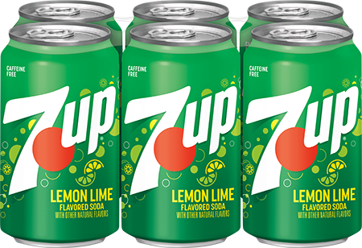
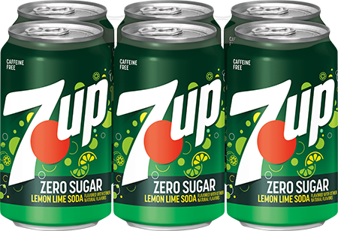
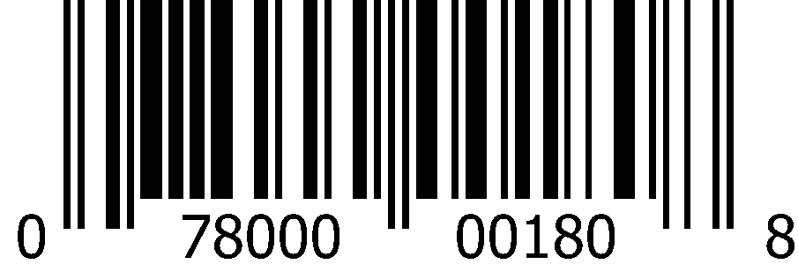
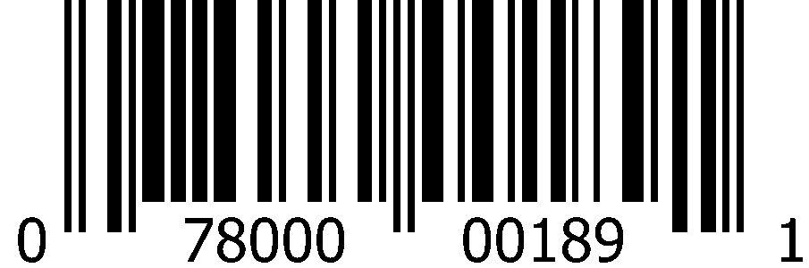
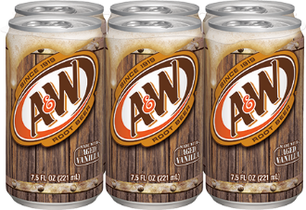
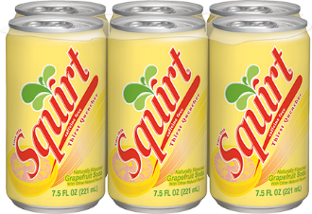
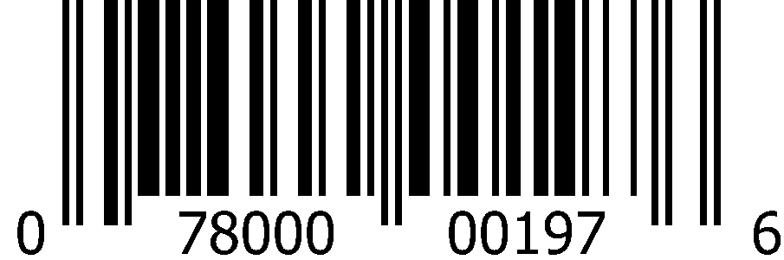
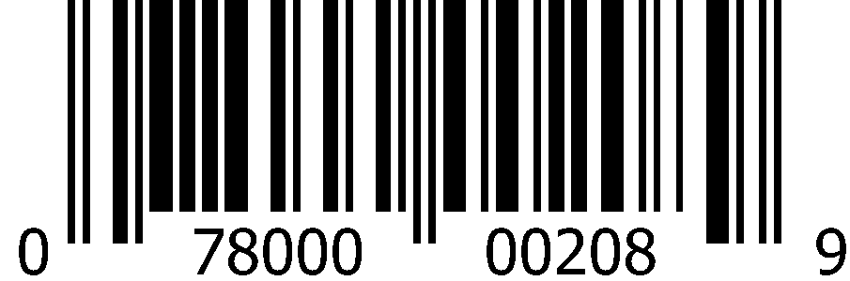
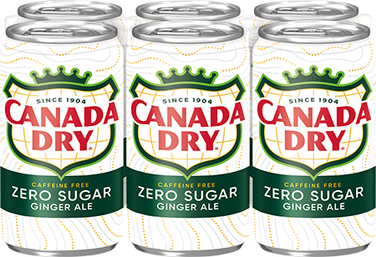
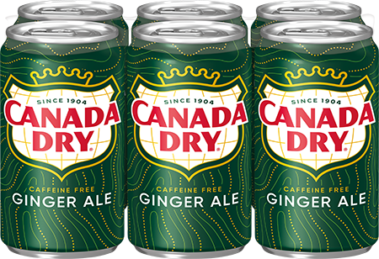
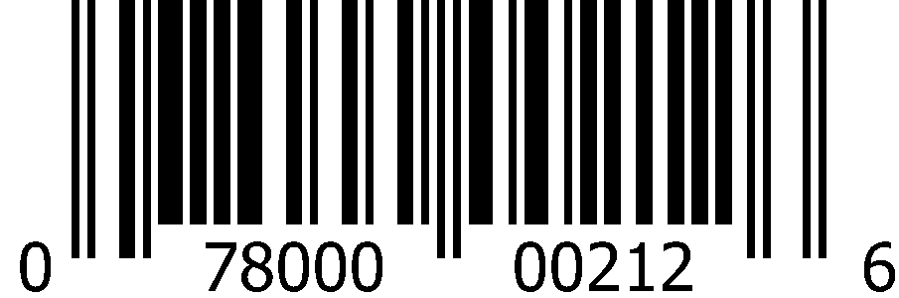
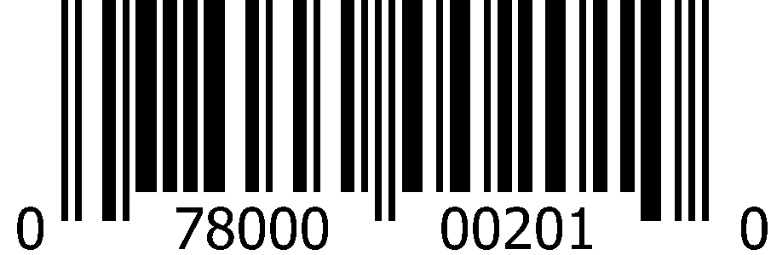
Carbonated Soft Drinks 7.5oz Slim Cans (4x6pk)
 | 7Up |  | 7Up Zero Sugar
 | 1008 5412 |  | 5413
 | 0-78000-00180-8 |  | 0-78000-00189-1
 | A&W Root Beer |  | Squirt
 | 1008 5415 |  | 1008 5424
 | 0-78000-00197-6 |  | 0-78000-00208-9
 | Canada Dry Ginger Ale Zero Sugar |  | Canada Dry Ginger Ale
 | 1008 6588 |  | 1008 5417
 | 0-78000-00212-6 |  | 0-78000-00201-0

Slide 3
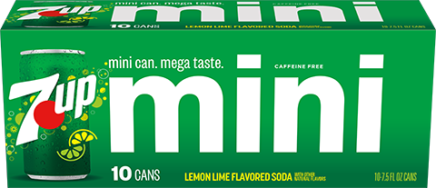
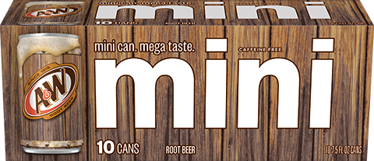
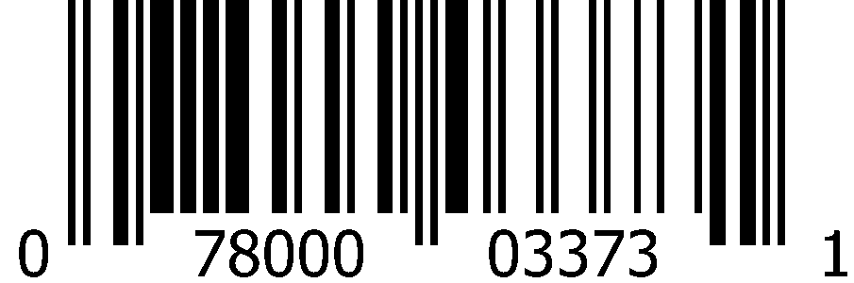
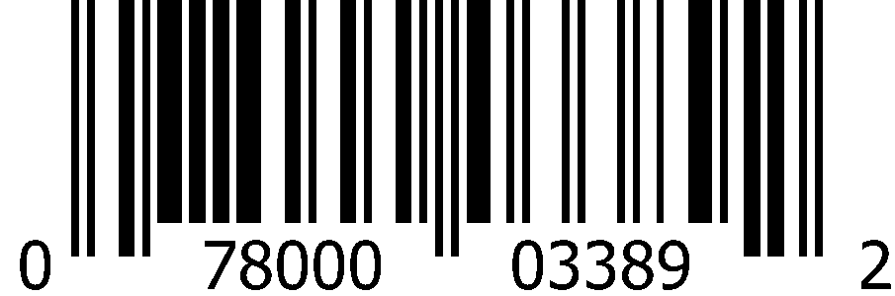
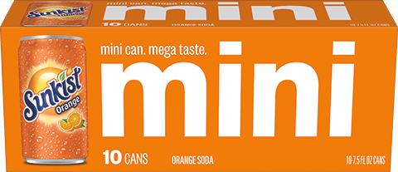
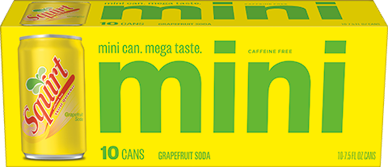
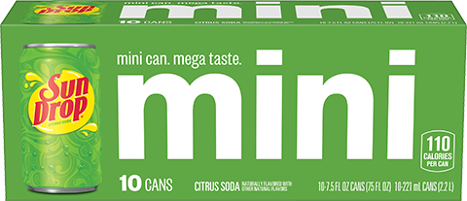
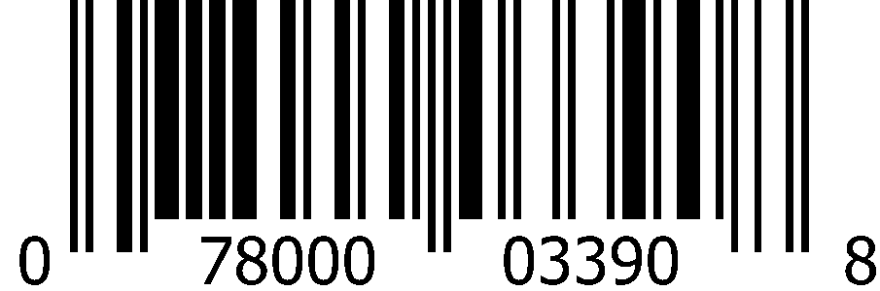
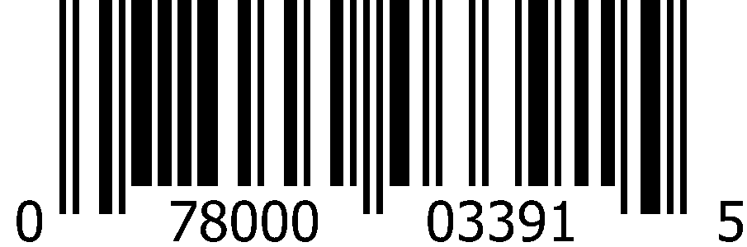
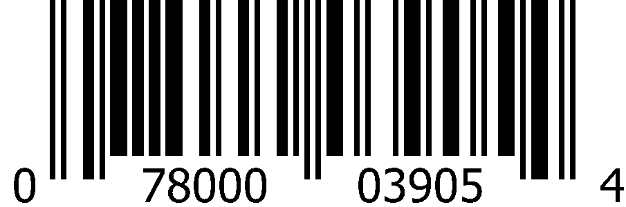
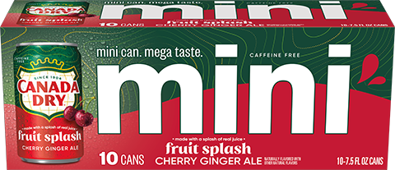
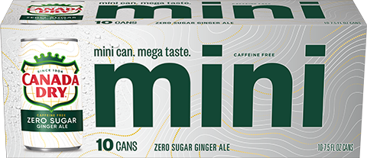
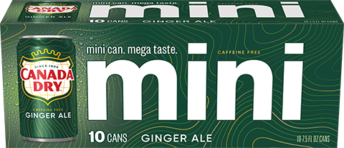
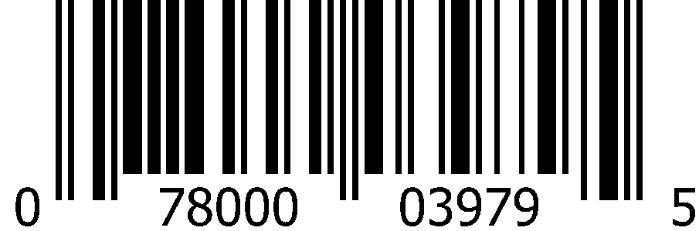

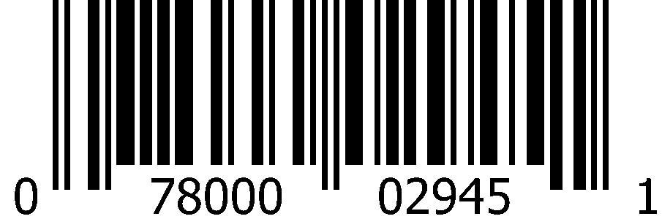
Carbonated Soft Drinks 7.5oz Slim Cans (3x10pk)
 | 7Up |  | A&W Root Beer
 | 1012 8315 |  | 1013 0141
 | 0-78000-03373-1 |  | 0-78000-03389-2
 | Sunkist Orange |  | Squirt |  | Sun Drop
 | 1013 0142 |  | 1013 0144 |  | 1016 5736
 | 0-78000-03390-8 |  | 0-78000-03391-5 |  | 0-78000-03905-4
 | Canada Dry Cherry Ginger Ale |  | Canada Dry Ginger Ale Zero Sugar |  | Canada Dry Ginger Ale
 | 1016 5973 |  | 1013 0140 |  | 1012 8316
 | 0-78000-03979-5 |  | 0-78000-03388-5 |  | 0-78000-02945-1

Slide 4
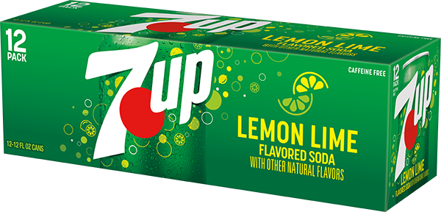
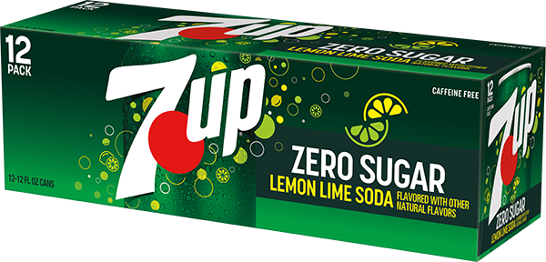
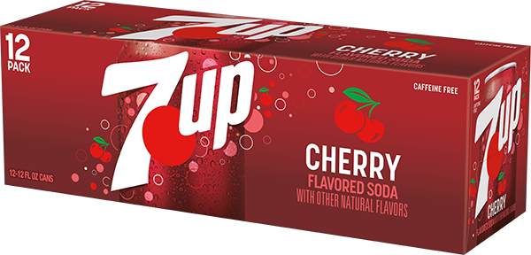
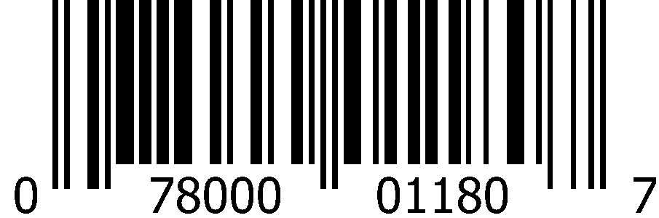
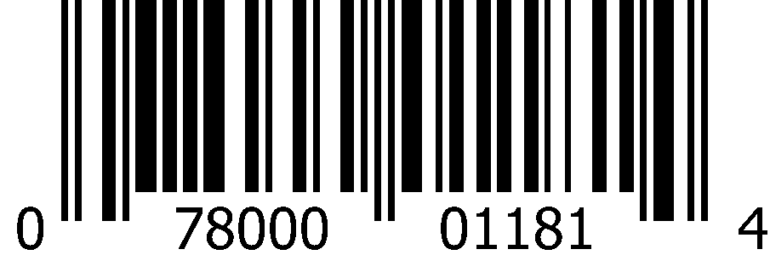
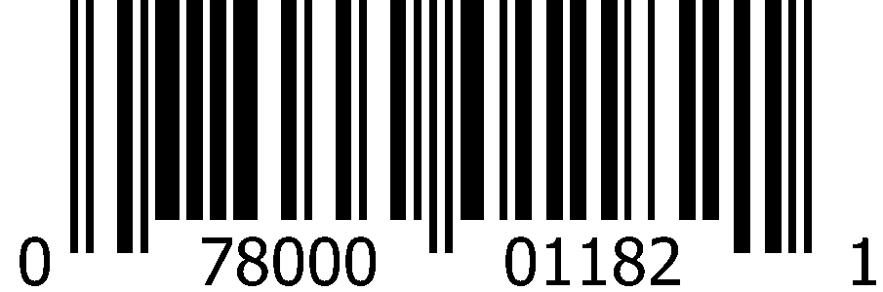
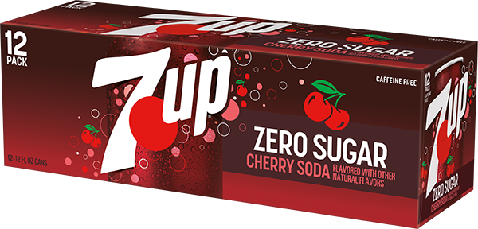
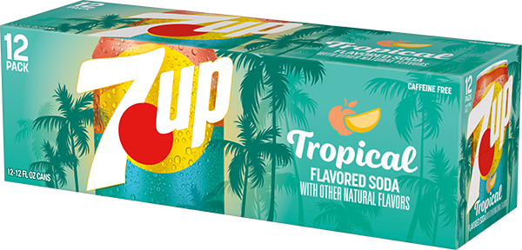
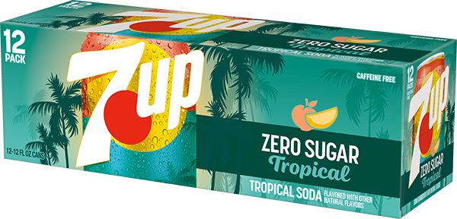
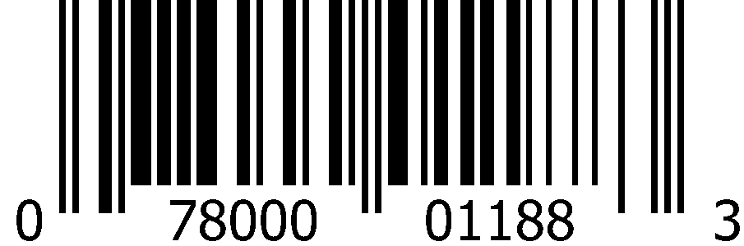
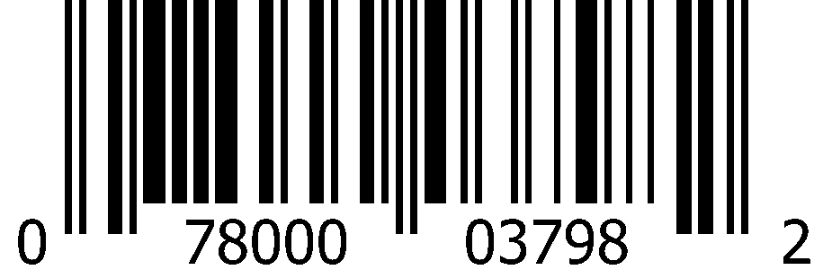
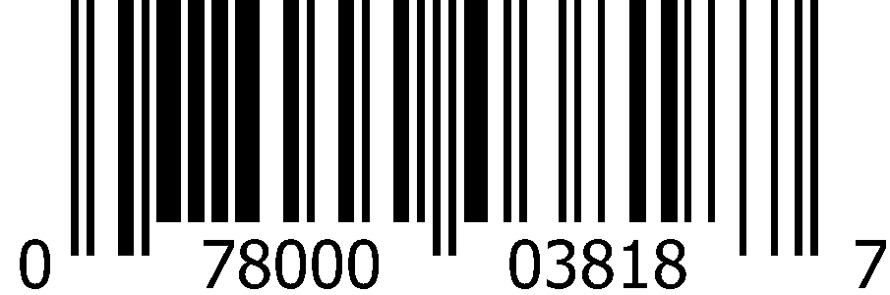
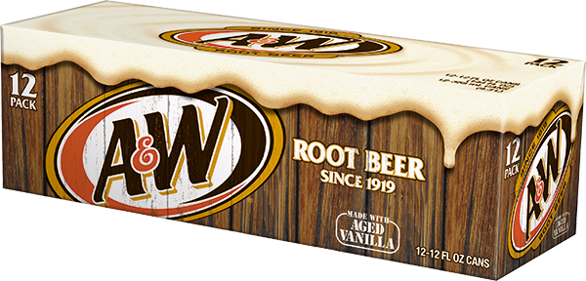
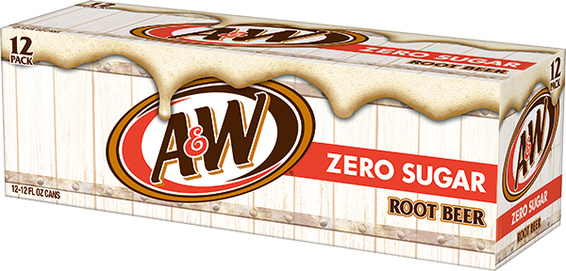
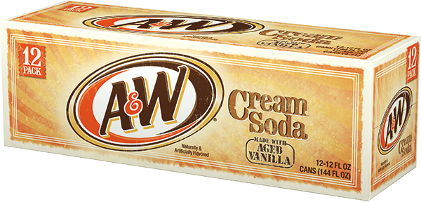
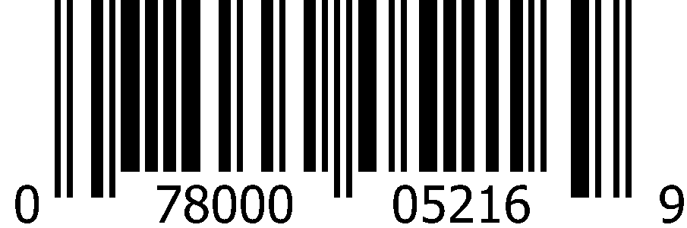
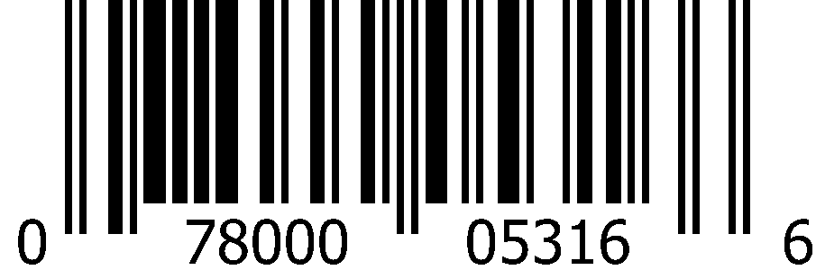
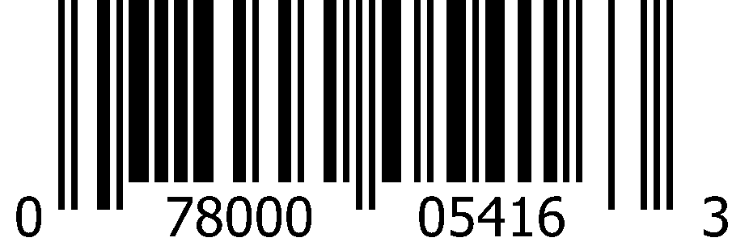
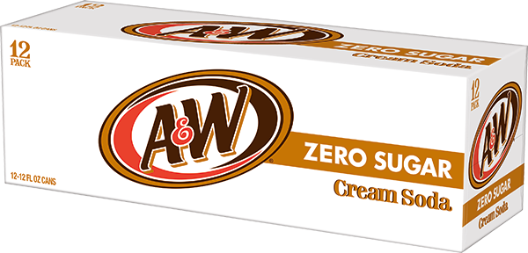
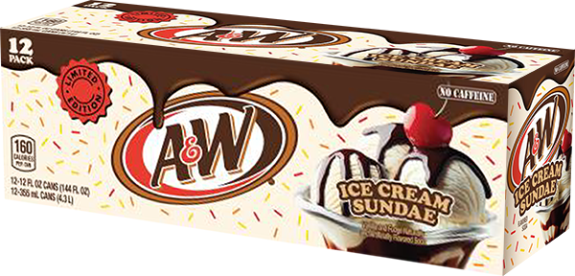
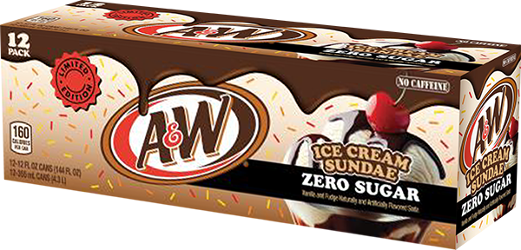
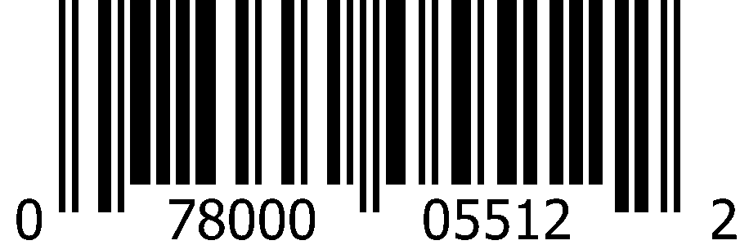
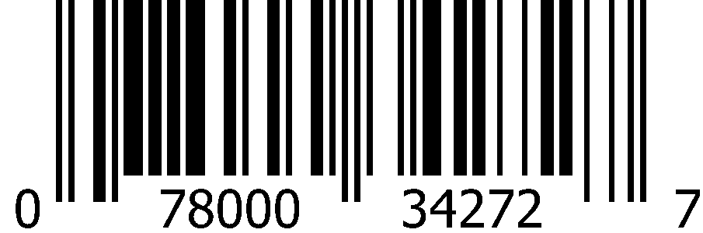

Carbonated Soft Drinks 12oz Cans (2x12pk)
 | 7Up |  | 7Up Zero Sugar |  | Cherry 7Up
 | 1000 0829 Deposit |  | 1000 0830 Deposit |  | 0833
 | 0-78000-01180-7 |  | 0-78000-01181-4 |  | 0-78000-01182-1
 | Cherry 7Up Zero Sugar |  | 7Up Tropical |  | 7Up Tropical Zero Sugar
 | 1000 0834 |  | 6397 |  | 1015 6395
 | 0-78000-01188-3 |  | 0-78000-03798-2 |  | 0-78000-03818-7
 | A&W Root Beer |  | A&W Root Beer Zero Sugar |  | A&W Cream Soda
 | 1000 0852 Deposit |  | 1000 0853 |  | 1000 0831
 | 0-78000-05216-9 |  | 0-78000-05316-6 |  | 0-78000-05416-3
 | A&W Cream Soda Zero Sugar |  | A&W Ice Cream Sundae |  | A&W Ice Cream Sundae Zero Sugar
 | 1000 0832 |  | 1016 4654 |  | 1016 4655
 | 0-78000-05512-2 |  | 0-78000-34272-7 |  | 0-78000-65794-4

Slide 5




















Carbonated Soft Drinks 12oz Cans (2x12pk)
 | RC Cola |  | RC Cola Zero Sugar |  | Cherry RC Cola
 | 1000 0838 |  | 1016 5232 |  | 1000 0179
 | 0-78000-04116-3 |  | 0-78000-04082-1 |  | 0-78000-04416-4
 | Sunkist Orange |  | Sunkist Orange Zero Sugar
 | 1000 0865 Deposit |  | 1000 0863
 | 0-78000-11316-7 |  | 0-78000-12216-9
 | Sunkist Berry Lemonade |  | Sunkist Strawberry Orange
 | 1013 7157 |  | 1015 8803
 | 0-78000-03555-1 |  | 0-78000-03850-7
 | Crush Orange |  | Sun Drop |  | Diet Sun Drop
 | 1002 1944 |  | 1000 0874 |  | 1000 0877
 | 0-78000-01305-4 |  | 0-78000-23016-1 |  | 0-78000-23116-8

Slide 6
















Carbonated Soft Drinks 12oz Cans (2x12pk)
 | Squirt |  | Squirt Zero Sugar |  | Ruby Red Squirt
 | 1000 0187 |  | 1000 0850 |  | 1000 0860
 | 0-78000-01616-1 |  | 0-78000-01716-8 |  | 0-78000-01816-5
 | Canada Dry Cranberry Ginger Ale |  | Canada Dry Fruit Splash Cherry Ginger Ale |  | Canada Dry Cherry Ginger Ale Zero Sugar
 | 1000 1994 |  | 1015 9681 |  | 1015 9680
 | 0-78000-15616-4 |  | 0-78000-03883-5 |  | 0-78000-03886-6
 | Canada Dry Ginger Ale Zero Sugar |  | Canada Dry Ginger Ale
 | 1000 0905 |  | 1000 0904
 | 0-78000-14816-9 |  | 0-78000-15216-6

Slide 7












Carbonated Soft Drinks 12oz Cans (18pk)
 | 7Up |  | Sunkist Orange |  | Big Red
 | 1001 5534 |  | 1001 5439 |  | 1002 1433
 | 0-78000-02002-1 |  | 0-78000-11308-2 |  | 0-71817-80009-1
 | RC Cola |  | RC Cola Zero Sugar |  | Cherry RC Cola
 | 1001 5532 |  | 1016 9105 |  | 1016 4706
 | 0-78000-01484-6 |  | 0-78000-04170-5 |  | 0-78000-03978-8

Slide 8














Carbonated Soft Drinks 12oz Cans (24pk)
 | 7Up |  | 7Up Zero Sugar
 | 1000 1034 |  | 1000 1035
 | 0-78000-01214-9 |  | 0-78000-01234-7
 | A&W Root Beer |  | RC Cola |  | Sunkist Orange
 | 1000 1044 |  | 1000 1039 |  | 1000 1048
 | 0-78000-05210-7 |  | 0-78000-04110-1 |  | 0-78000-11310-5
 | Squirt |  | Canada Dry Ginger Ale
 | 1000 1043 |  | 1000 6264
 | 0-78000-01610-9 |  | 0-78000-15210-4

Slide 9





Carbonated Soft Drinks 16oz Cans (24pk)
 | 7Up |  | A&W Root Beer |  | Sunkist Orange |  | Canada Dry Ginger Ale
 | 1008 9301 |  | 1008 9269 |  | 1008 6430 |  | 1008 9257
 | 0-78000-00039-9 |  | 0-78000-05223-7 |  | 0-78000-11323-5 |  | 0-78000-02439-5
 | RC Cola |  | RC Berries and Cream
 | 1015 7739 |  | 1014 9170
 | 0-78000-04123-1 |  | 0-78000-03699-2

Slide 10

Carbonated Soft Drinks 12oz Bottles (3x8pk)
 | 7Up |  | 7Up Zero Sugar |  | A&W Root Beer
 | 1000 2282 |  | 1000 2283 |  | 1000 2281
 | 0-78000-01280-4 |  | 0-78000-01281-1 |  | 0-78000-05288-6
 | Squirt |  | Canada Dry Ginger Ale Zero Sugar |  | Canada Dry Ginger Ale
 | 1002 8020 |  | 1008 3872 |  | 1004 5978
 | 0-78000-01688-8 |  | 0-78000-14888-6 |  | 0-78000-15288-3

Slide 11
Carbonated Soft Drinks 16.9oz Bottles (4x6pk)
 | 7Up |  | 7Up Zero Sugar
 | 1000 1236 |  | 1000 1237
 | 0-78000-01219-4 |  | 0-78000-01223-1
 | A&W Root Beer |  | A&W Root Beer Zero Sugar |  | A&W Cream Soda
 | 1000 1251 |  | 1000 1252 |  | 1000 1238
 | 0-78000-05242-8 |  | 0-78000-05342-5 |  | 0-78000-05442-2
 | Sunkist Orange |  | Sunkist Orange Zero Sugar
 | 1000 1257 |  | 1000 1256
 | 0-78000-11342-6 |  | 0-78000-00676-6

Slide 12




Carbonated Soft Drinks 16.9oz Bottles (4x6pk)
 | Crush Orange |  | Squirt
 | 1002 1949 |  | 1000 1249
 | 0-78000-01325-2 |  | 0-78000-00369-7
 | Canada Dry Ginger Ale Zero Sugar |  | Canada Dry Ginger Ale
 | 1000 2576 |  | 1000 1266
 | 0-78000-14842-8 |  | 0-78000-00117-4

Slide 13


















Carbonated Soft Drinks 20oz Bottles (24pk)
 | 7Up |  | 7Up Zero Sugar |  | Cherry 7Up
 | 1000 1108 |  | 1000 1091 |  | 1000 1110
 | 0-78000-00161-7 |  | 0-78000-00162-4 |  | 0-78000-00554-7
 | 7Up Tropical |  | 7Up Tropical Zero Sugar
 | 1015 6396 |  | 1016 5726
 | 0-78000-03795-1 |  | 0-78000-04145-3
 | A&W Root Beer |  | A&W Root Beer Zero Sugar |  | A&W Cream Soda |  | A&W Ice Cream Sundae
 | 1000 1096 |  | 1000 1122 |  | 1000 1109 |  | 1016 2816
 | 0-78000-05240-4 |  | 0-78000-05340-1 |  | 0-78000-05440-8 |  | 0-78000-67980-9

Slide 14


















Carbonated Soft Drinks 20oz Bottles (24pk)
 | RC Cola |  | Big Red |  | Sun Drop |  | Diet Sun Drop
 | 1000 1111 |  | 1000 1128 |  | 1000 1751 |  | 1000 1134
 | 0-78000-04140-8 |  | 0-71817-00037-8 |  | 0-78000-23040-6 |  | 0-78000-23140-3
 | Sunkist Orange |  | Sunkist Orange Zero Sugar
 | 1000 1130 |  | 1000 1129
 | 0-78000-11340-2 |  | 0-78000-12240-4
 | Sunkist Berry Lemonade |  | Sunkist Raspberry Blood Orange |  | Sunkist Grape
 | 1013 6557 |  | 1016 4769 |  | 1000 1704
 | 0-78000-03520-9 |  | 0-78000-39540-2 |  | 0-78000-11640-3

Slide 15
















Carbonated Soft Drinks 20oz Bottles (24pk)
 | Crush Orange |  | Crush Strawberry |  | Crush Grape
 | 1002 1990 |  | 1002 1993 |  | 1002 1992
 | 0-78000-01328-3 |  | 0-78000-01369-6 |  | 0-78000-01352-8
 | Squirt |  | Squirt Zero Sugar |  | Ruby Red Squirt
 | 1000 1120 |  | 1000 1121 |  | 1000 1127
 | 0-78000-01640-6 |  | 0-78000-01740-3 |  | 0-78000-01840-0
 | Canada Dry Fruit Splash Cherry Ginger Ale |  | Canada Dry Ginger Ale
 | 1015 9682 |  | 1000 1150
 | 0-78000-03888-0 |  | 0-78000-15240-1

Slide 16












Carbonated Soft Drinks 1L Bottles (15pk)
 | 7Up |  | A&W Root Beer |  | RC Cola
 | 1000 1315 |  | 1000 1323 |  | 1000 1319
 | 0-78000-00028-3 |  | 0-78000-05245-9 |  | 0-78000-00319-2
 | Sunkist Orange |  | Squirt |  | Canada Dry Ginger Ale
 | 1000 1332 |  | 1000 1322 |  | 1000 1335
 | 0-78000-11345-7 |  | 0-78000-01645-1 |  | 0-78000-15245-6

Slide 17








Carbonated Soft Drinks 1.25L Bottles (12pk)
 | 7Up |  | A&W Root Beer
 | 1010 7491 |  | 1010 7490
 | 0-78000-02659-7 |  | 0-78000-02657-3
 | Squirt |  | Canada Dry Ginger Ale
 | 1010 7461 |  | 1010 7539
 | 0-78000-03069-3 |  | 0-78000-01154-8

Slide 18














Carbonated Soft Drinks 2L Bottles (8pk)
 | 7Up |  | 7Up Zero Sugar
 | 1000 1415 |  | 1000 1416
 | 0-78000-00034-4 |  | 0-78000-00075-7
 | Cherry 7Up |  | Cherry 7Up Zero Sugar
 | 1000 1419 |  | 1000 1420
 | 0-78000-00531-8 |  | 0-78000-00831-9
 | A&W Root Beer |  | A&W Root Beer Zero Sugar |  | A&W Cream Soda
 | 1000 1437 |  | 1000 1438 |  | 1000 1417
 | 0-78000-05246-6 |  | 0-78000-05346-3 |  | 0-78000-05446-0

Slide 19


















Carbonated Soft Drinks 2L Bottles (8pk)
 | RC Cola |  | RC Cola Zero Sugar
 | 1000 1424 |  | 1016 5424
 | 0-78000-00337-6 |  | 0-78000-04112-5
 | Sunkist Orange |  | Sunkist Orange Zero Sugar |  | Sunkist Berry Lemonade |  | Sunkist Strawberry Lemonade
 | 1000 1455 |  | 1000 1454 |  | 1013 7158 |  | 1012 0686
 | 0-78000-11346-4 |  | 0-78000-12246-6 |  | 0-78000-03554-4 |  | 0-78000-03180-5
 | Crush Orange |  | Crush Grape |  | Crush Strawberry
 | 1002 1981 |  | 1002 1983 |  | 1002 1984
 | 0-78000-01336-8 |  | 0-78000-01356-6 |  | 0-78000-01371-9

Slide 20














Carbonated Soft Drinks 2L Bottles (8pk)
 | Squirt |  | Squirt Zero Sugar |  | Ruby Red Squirt
 | 1000 1435 |  | 1000 1436 |  | 1000 0096
 | 0-78000-01646-8 |  | 0-78000-01746-5 |  | 0-78000-01846-2
 | Canada Dry Cranberry Ginger Ale |  | Canada Dry Fruit Splash Cherry Ginger Ale
 | 1000 1595 |  | 1016 5904
 | 0-78000-15646-1 |  | 0-78000-03940-5
 | Canada Dry Ginger Ale Zero Sugar |  | Canada Dry Ginger Ale
 | 1000 1488 |  | 1000 1487
 | 0-78000-14846-6 |  | 0-78000-15246-3

Slide 21














Carbonated Soft Drinks 2L Bottles $1.49 PP (8pk)
 | Sunkist Orange |  | Sunkist Berry Lemonade |  | Sunkist Cherry Limeade
 | 1016 1412 |  | 1016 1440 |  | 1016 1419
 | 0-78000-03957-3 |  | 0-78000-03964-1 |  | 0-78000-03969-6
 | Sunkist Strawberry |  | Sunkist Pineapple
 | 1016 1427 |  | 1016 1439
 | 0-78000-03951-1 |  | 0-78000-03952-8
 | Cherry RC Cola |  | RC Cola
 | 1016 1418 |  | 1016 1426
 | 0-78000-03949-8 |  | 0-78000-03948-1

Slide 22




Carbonated Soft Drinks Premium Glass
355mL Mexican Glass (12pk)
 | 7Up |  | Squirt
 | 2002 6451 |  | 2002 6453
 | 0-78000-01954-4 |  | 0-78000-01952-0

Slide 23










CSD Bag-In-A-Box Fountain Syrup (2.5 gallon)
 | 7Up
 | 1000 0321
 | 0-78000-20011-9
 | IBC Root Beer |  | Hawaiian Punch Fruit Juicy Red |  | Hawaiian Punch Lemonade
 | 1000 1732 |  | 1000 0329 |  | 1008 8270
 | 0-88500-90224-6 |  | 0-88500-90277-2 |  | 0-88500-00118-5
 | Sunkist Orange |  | Squirt |  | RC Cola
 | 1000 00327 |  | 1000 0232 |  | 1000 0261
 | 0-88500-90119-5 |  | 0-88500-90171-3 |  | 0-88500-90248-2

Slide 24






Canada Dry 1L Bottles (15pk)
 | Tonic Water |  | Tonic Water Zero Sugar |  | Club Soda
 | 1000 0071 |  | 1000 1334 |  | 1000 1336
 | 0-78000-15345-3 |  | 0-78000-14945-6 |  | 0-78000-14645-5

Slide 25













Canada Dry Mixers
7.5oz Slim Cans (4x6pk)
 | Tonic Water |  | Tonic Water Zero Sugar |  | Club Soda
 | 1016 0714 |  | 1016 0704 |  | 1016 0712
 | 0-78000-00224-9 |  | 0-78000-00225-6 |  | 0-78000-00223-2
10oz PET Bellyband Bottles (4x6pk)
 | Tonic Water |  | Tonic Water Zero Sugar
 | 1011 4958 |  | 1011 4953
 | 0-78000-00365-9 |  | 0-78000-00342-0
 | Ginger Ale |  | Club Soda
 | 1011 4954 |  | 1011 4955
 | 0-78000-00364-2 |  | 0-78000-00341-3

Slide 26


















Polar Sparkling Seltzer 12oz Cans (3x8pk)
 | Black Cherry |  | Cranberry Lime |  | Lime
 | 1013 8355 |  | 1013 8361 |  | 1013 8365
 | 0-71537-00366-6 |  | 0-71537-00364-2 |  | 0-71537-00367-3
 | Original |  | Orange Vanilla |  | Raspberry Lime
 | 1013 8360 |  | 1015 2004 |  | 1013 8362
 | 0-71537-00365-9 |  | 0-71537-30161-8 |  | 0-71537-00363-5
 | Ruby Red Grapefruit |  | Cranberry Clementine |  | Georgia Peach
 | 1013 8357 |  | 1016 8496 |  | 1016 8495
 | 0-71537-00368-0 |  | 0-71537-30383-4 |  | 0-71537-30338-4

Slide 27










Polar Sparkling Seltzer 12oz Cans (3x8pk)
 | Blackberry Mango |  | Strawberry Watermelon |  | Ginger Lime Mule
 | 1016 0447 |  | 1015 5919 |  | 1015 2006
 | 0-71537-30382-7 |  | 0-71537-30389-6 |  | 0-71537-00326-0
 | Pink Apple & Lemon |  | Lemon
 | 1014 9358 |  | 1015 2002
 | 0-71537-00374-1 |  | 0-71537-30134-2

Slide 28










Polar Sparkling Seltzer 20oz Bottles (24pk)
 | Black Cherry |  | Lemon |  | Ruby Red Grapefruit
 | 1013 8421 |  | 1013 8424 |  | 1013 8422
 | 0-71537-06028-7 |  | 0-71537-06034-8 |  | 0-71537-06025-6
 | Lime |  | Original
 | 1016 9240 |  | 1016 9239
 | 0-71537-06035-5 |  | 0-71537-06020-1

Slide 29














Polar Sparkling Seltzer 1L Bottles (12pk)
 | Raspberry Lime |  | Lime |  | Black Cherry
 | 1013 8390 |  | 1013 8406 |  | 1013 8391
 | 0-71537-02030-4 |  | 0-71537-02035-9 |  | 0-71537-02028-1
 | Original |  | Mandarin
 | 1013 8414 |  | 1013 8407
 | 0-71537-02020-5 |  | 0-71537-02044-1
 | Blueberry Lemonade |  | Ruby Red Grapefruit
 | 1013 8395 |  | 1013 8409
 | 0-71537-02040-3 |  | 0-71537-02025-0

Slide 30






















Bai 18oz Bottles (12pk)
 | Molokai Coconut |  | Puna Coconut Pineapple |  | Shala Coconut Strawberry
 | 1015 9894 |  | 1015 9895 |  | 1016 4534
 | 8-13694-02671-9 |  | 8-13694-02673-3 |  | 8-13694-02719-8
 | Brasilia Blueberry |  | Kula Watermelon |  | Kupang Strawberry Kiwi |  | Zambia Bing Cherry
 | 1015 9908 |  | 1015 9909 |  | 1016 0135 |  | 1015 9911
 | 8-13694-02665-8 |  | 8-13694-02669-6 |  | 8-13694-02690-0 |  | 8-13694-02667-2
 | Costa Rica Clementine |  | Simbu Strawberry |  | Rubi Raspberry Lemon Lime |  | São Paulo Strawberry Lemonade
 | 1016 0136 |  | 1016 2805 |  | 1015 9305 |  | 1016 0140
 | 8-13694-02688-7 |  | 8-13694-02714-3 |  | 8-13694-02639-9 |  | 8-13694-02693-1

Slide 31














Bai 14oz Bottles (4x6pk)
 | Molokai Coconut |  | Puna Coconut Pineapple
 | 1015 9732 |  | 1015 9735
 | 8-13694-02656-6 |  | 8-13694-02657-3
 | Brasilia Blueberry |  | Kula Watermelon |  | Zambia Bing Cherry
 | 1015 9734 |  | 1015 9731 |  | 1015 9733
 | 8-13694-02653-5 |  | 8-13694-02655-9 |  | 8-13694-02654-2
 | Simbu Strawberry |  | Rubi Raspberry Lemon Lime
 | 1016 2806 |  | 1015 9303
 | 8-13694-02717-4 |  | 8-13694-02642-9

Slide 32








Snapple 8oz Bottles (2x8pk)
 | Lemon Tea |  | Peach Tea
 | 1017 3862 |  | 1015 9535
 | 0-76183-00957-4 |  | 0-76183-00923-9
 | Kiwi Strawberry |  | Snapple Apple
 | 1015 8700 |  | 1015 8699
 | 0-76183-00909-3 |  | 0-76183-00911-6

Slide 33
























Snapple 16oz Bottles (12pk)
 | Lemon Tea |  | Peach Tea |  | Zero Sugar Peach Tea |  | Zero Sugar Raspberry Tea
 | 1017 3872 |  | 1013 6509 |  | 1013 6532 |  | 1013 6533
 | 0-76183-00315-2 |  | 0-76183-00311-4 |  | 0-76183-00314-5 |  | 0-76183-00321-3
 | Kiwi Strawberry |  | Mango Madness |  | Fruit Punch |  | Snapple Apple
 | 1013 6515 |  | 1013 6517 |  | 1013 6514 |  | 1013 6538
 | 0-76183-00310-7 |  | 0-76183-00312-1 |  | 0-76183-00313-8 |  | 0-76183-00328-2
 | Peach Tea & Lemonade |  | Half ‘n Half Lemonade Iced Tea |  | Pink Lemonade |  | Watermelon Lemonade
 | 1016 4997 |  | 1013 6504 |  | 1017 3825 |  | 1013 6470
 | 0-76183-47550-8 |  | 0-76183-00316-9 |  | 0-76183-00329-9 |  | 0-76183-45512-8

Slide 34


















Snapple 16oz Bottles (4x6pk)
 | Lemon Tea |  | Zero Sugar Lemon Tea |  | Peach Tea
 | 1017 3811 |  | 1017 3868 |  | 1013 7150
 | 0-76183-00764-8 |  | 0-76183-00804-1 |  | 0-76183-00766-2
 | Zero Sugar Peach Tea |  | Zero Sugar Raspberry Tea |  | Peach Tea & Lemonade
 | 1013 7149 |  | 1013 6570 |  | 1016 4999
 | 0-76183-00774-7 |  | 0-76183-00817-1 |  | 0-76183-47554-6
 | Zero Sugar Half ‘n Half Lemonade Iced Tea |  | Kiwi Strawberry |  | Snapple Apple
 | 1013 6475 |  | 1013 7148 |  | 1013 7145
 | 0-76183-00798-3 |  | 0-76183-00777-8 |  | 0-76183-00771-6

Slide 35










Snapple 16oz Bottles (2x12pk)
 | Peach Tea |  | Zero Sugar Peach Tea
 | 1013 6526 |  | 1013 6481
 | 0-76183-00783-9 |  | 0-76183-00813-3
 | Kiwi Strawberry
 | 1013 6572
 | 0-76183-00776-1
 | Lemon Tea |  | Peach Tea & Lemonade
 | 1017 3809 |  | 1016 5237
 | 0-76183-00786-0 |  | 0-76183-00960-4

Slide 36














Snapple 32oz Bottles (12pk)
 | Peach Tea |  | Zero Sugar Peach Tea |  | Pink Lemonade
 | 1000 3023 |  | 1000 3024 |  | 1016 4794
 | 0-76183-32356-4 |  | 0-76183-32357-1 |  | 0-76183-08795-4
 | Kiwi Strawberry |  | Mango Madness |  | Fruit Punch |  | Snapple Apple
 | 1000 3025 |  | 1000 3037 |  | 1000 3038 |  | 1008 8249
 | 0-76183-32363-2 |  | 0-76183-32364-9 |  | 0-76183-32372-4 |  | 0-76183-32850-7

Slide 37










Snapple 64oz Bottles (8pk)
 | Peach Tea |  | Zero Sugar Peach Tea |  | Zero Sugar Half ‘n Half Lemonade Iced Tea
 | 1000 2904 |  | 1000 2905 |  | 1001 4793
 | 0-76183-64356-3 |  | 0-76183-64357-0 |  | 0-76183-00022-9
 | Kiwi Strawberry |  | Snapple Apple
 | 1000 2906 |  | 1008 8248
 | 0-76183-64363-1 |  | 0-76183-64387-7

Slide 38




Yoo-hoo / Clamato
 | Chocolate 15.5oz Glass (24pk)
 | 1000 6323
 | 0-72350-00011-5
 | Original 32oz PET
 | 1001 1920
 | 0-14800-51324-0

Slide 39






















La Colombe Cold Brew Draft Latte 11oz Cans (12pk)
 | Triple Draft Latte |  | Vanilla Draft Latte |  | Oatmilk Vanilla Draft Latte
 | 2003 5333 |  | 2003 5332 |  | 2003 5325
 | 6-04913-00488-1 |  | 6-04913-00490-4 |  | 6-04913-00520-8
 | Mocha Draft Latte |  | Caramel Draft Latte |  | Double Draft Latte |  | Black Cold Brew
 | 2003 5334 |  | 2003 5767 |  | 2003 5765 |  | 2003 5763
 | 6-04913-00489-8 |  | 6-04913-00491-1 |  | 6-04913-00530-7 |  | 6-04913-00534-5
 | Strawberry Mocha Draft Latte |  | S’mores Latte Draft Latte |  | Pumpkin Spice Draft Latte |  | Peppermint Mocha Draft Latte
 | 2003 9270 |  | 2003 9269 |  | 2003 6698 |  | 2003 6696
 | 6-04913-00562-8 |  | 6-04913-00557-4 |  | 6-04913-00542-0 |  | 6-04913-00541-3

Slide 40


















La Colombe Cold Brew Draft Latte 9oz Cans (4x4pk)
 | Vanilla Draft Latte |  | Triple Draft Latte |  | Mocha Draft Latte
 | 2003 5324 |  | 5323 |  | 2003 5326
 | 6-04913-00015-9 |  | 6-04913-00016-6 |  | 6-04913-00014-2
 | Oatmilk Vanilla Draft Latte |  | Caramel Draft Latte |  | Strawberry Mocha Draft Latte
 | 2003 5330 |  | 5764 |  | 2003 9339
 | 6-04913-00268-9 |  | 6-04913-00094-4 |  | 6-04913-00566-6
 | S’mores Latte Draft Latte |  | Pumpkin Spice Draft Latte |  | Peppermint Mocha Draft Latte
 | 2003 9337 |  | 2003 7221 |  | 2003 7222
 | 6-04913-00561-1 |  | 6-04913-00041-8 |  | 6-04913-00044-9

Slide 41


























Electrolit 21oz Bottles (12pk)
 | Grape |  | Strawberry Kiwi |  | Fruit Punch
 | 2003 5821 |  | 2003 5823 |  | 2003 5831
 | 8-87725-00000-9 |  | 8-87725-00025-2 |  | 8-87725-00045-0
 | Coconut |  | Orange |  | Blue Raspberry
 | 2003 5818 |  | 2003 5819 |  | 2003 5837
 | 8-87725-00004-7 |  | 8-87725-00005-4 |  | 8-87725-00130-3
 | Watermelon Lime |  | Green Apple |  | Berry Bliss |  | Lemon Lime
 | 2003 5842 |  | 2003 5840 |  | 2003 5830 |  | 2003 5824
 | 8-87725-00180-8 |  | 8-87725-00177-8 |  | 8-87725-00043-6 |  | 8-87725-00006-1
 | Zero Strawberry Banana |  | Zero Fruit Punch Splash |  | Zero Blue Raspberry
 | 2003 5841 |  | 2003 5839 |  | 2003 5833
 | 8-87725-00129-7 |  | 8-87725-00065-8 |  | 8-87725-00128-0

Slide 42








Electrolit 12oz Bottles (4x6pk)
 | Grape |  | Fruit Punch
 | 2003 8833 |  | 2003 8835
 | 8-87725-00218-8 |  | 8-87725-00217-1
 | Blue Raspberry |  | Zero Strawberry Banana
 | 2003 8836 |  | 2003 8834
 | 8-87725-00215-7 |  | 8-87725-00219-5

Slide 43
























C4 Performance Energy 16oz Cans (12pk)
 | Frozen Bombsicle |  | Strawberry Blast |  | Cosmic Rainbow |  | Sour Gummy Splash
 | 2003 4426 |  | 2003 4425 |  | 2003 4450 |  | 1017 0100
 | 8-42595-10659-6 |  | 8-42595-12175-9 |  | 8-42595-12176-6 |  | 8-42595-13605-0
 | Popsicle Grape |  | Popsicle Cherry |  | Creamsicle |  | Popsicle Hawaiian Pineapple
 | 2003 5281 |  | 2003 5283 |  | 2003 5742 |  | 2003 5284
 | 8-42595-13127-7 |  | 8-42595-13125-3 |  | 8-42595-13162-8 |  | 8-42595-13129-1
 | Jolly Rancher Green Apple |  | Jolly Rancher Watermelon |  | Jolly Rancher Blue Raspberry |  | Hawaiian Punch Fruit Juicy Red
 | 2003 5742 |  | 2003 4425 |  | 2003 4450 |  | 2003 7607
 | 8-42595-13497-1 |  | 8-42595-13496-4 |  | 8-42595-13495-7 |  | 8-42595-13360-8

Slide 44












C4 Performance Energy
16oz Cans (12pk)
 | Orange Slice |  | Strawberry Watermelon Ice
 | 2003 4441 |  | 2003 4435
 | 8-42595-10936-8 |  | 8-42595-10657-2
12oz Cans (6x4pk)
 | Frozen Bombsicle |  | Strawberry Blast |  | Popsicle Cherry
 | 2003 4424 |  | 2003 4415 |  | 2003 5285
 | 8-42595-11304-4 |  | 8-42595-12784-3 |  | 8-42595-13144-4
Variety Pack 12oz Cans (12pk)
 | Popsicle Variety Pack
 | 2003 5287
 | 8-42595-13297-7

Slide 45




















C4 Ultimate Energy 16oz Cans (12pk)
 | Arctic Snow Cone |  | Fruit Punch |  | Electric Sour Apple |  | Atomic Grape
 | 2003 4437 |  | 2003 4440 |  | 1017 0158 |  | 1017 0162
 | 8-42595-10661-9 |  | 8-42595-12165-0 |  | 8-42595-13172-7 |  | 8-42595-13174-1
 | Berry Powerbomb |  | Ruthless Raspberry |  | Nectarine Guava Knockout
 | 2003 5274 |  | 2003 5278 |  | 1016 8531
 | 8-42595-12959-5 |  | 8-42595-12960-1 |  | 8-42595-13171-0
 | Frost Bitten Citrus |  | Tropical Tundra Frost |  | Cherry Bomb Frost
 | 1017 0160 |  | 1017 0161 |  | 1017 0159
 | 8-42595-13553-4 |  | 8-42595-13555-8 |  | 8-42595-13554-1

Slide 46










C4 Smart Energy 12oz Cans (12pk)
 | Strawberry Guava |  | Peach Mango |  | Cherry Berry Lime
 | 2003 4412 |  | 2003 4420 |  | 2003 4413
 | 8-42595-12692-1 |  | 8-42595-11708-0 |  | 8-42595-11983-1
 | Blood Orange Yuzu |  | Watermelon Burst
 | 2003 4410 |  | 2003 4448
 | 8-42595-12690-7 |  | 8-42595-12509-2

Slide 47






C4 Smart Energy 12oz Cans (12pk)
 | Cherry Berry Lime |  | Strawberry Guava |  | Peach Mango
 | 2003 4413 |  | 2003 4412 |  | 2003 4420
 | 8-42595-11983-1 |  | 8-42595-12692-1 |  | 8-42595-11708-0
 | Watermelon Burst |  | Tropical Passionfruit
 | 2003 4448 |  | 2003 4416
 | 8-42595-12509-2 |  | 8-42595-12686-0

Slide 48








Black Rifle Energy 16oz Cans (12pk)
 | Freedom Punch |  | Wild Frost
 | 1017 0029 |  | 1017 0028
 | 8-10140-15771-3 |  | 8-10140-15762-1
 | Ranger Berry |  | Project Mango
 | 1017 0027 |  | 1017 0030
 | 8-10140-15768-3 |  | 8-10140-15765-2

Slide 49
















Bloom Sparkling Energy 12oz Cans (12pk)
 | Strawberry Watermelon |  | Raspberry Lemon |  | Peach Mango
 | 2003 8850 |  | 2003 8851 |  | 2003 8852
 | 8-42595-13509-1 |  | 8-42595-13508-4 |  | 8-42595-13507-7
 | Juicy Orange |  | Cherry Lime
 | 2003 8854 |  | 2003 8853
 | 8-42595-13661-6 |  | 8-42595-13506-0
 | Strawberry Watermelon (4x6pk) |  | Raspberry Lemon (4x6pk) |  | Variety Pack (1x12pk)
 | 2003 8856 |  | 2003 8855 |  | 2003 8857
 | 8-42595-13644-9 |  | 8-42595-13645-6 |  | 8-42595-13646-3

Slide 50








Venom 16oz Cans (24pk)
 | Original |  | Mango
 | 1014 6508 |  | 1014 6510
 | 0-78000-02374-9 |  | 0-78000-02376-3
 | Fruit Punch |  | Black Cherry Kiwi
 | 1014 6509 |  | 1014 6511
 | 0-78000-02375-6 |  | 0-78000-02868-3

Slide 51




















Vita Coco 500mL Tetra Paks
500mL Tetra Paks (12pk)
 | Original |  | Pineapple |  | Peach & Mango
 | 2000 0642 |  | 2000 0643 |  | 2000 0644
 | 8-98999-01000-7 |  | 8-98999-03000-5 |  | 8-98999-04000-4
 | Extra Coconut |  | Pure Farmer’s Organic |  | Strawberries & Cream |  | Orange Cream
 | 2002 6703 |  | 2003 4309 |  | 2003 8814 |  | 2003 8815
 | 8-98999-01014-4 |  | 8-98999-01226-1 |  | 8-98999-01352-7 |  | 8-98999-01379-4
500mL Tetra Paks (6x4pk)
 | Original |  | Pressed Coconut |  | Pineapple
 | 2000 7583 |  | 2003 1761 |  | 2003 3809
 | 8-98999-01200-1 |  | 8-98999-01185-1 |  | 8-98999-01221-6

Slide 52














Vita Coco
1L Tetra Paks (12pk)
 | Original |  | Pineapple |  | Extra Coconut |  | Pure Farmer’s Organic
 | 2000 0631 |  | 2002 0822 |  | 2002 8242 |  | 2003 2453
 | 8-98999-00050-3 |  | 8-98999-00618-5 |  | 8-98999-01128-8 |  | 8-98999-00099-2
Vita Coco Multi-packs
 | Pure (4x4pk) |  | 330mL Pure 12pk |  | 330mL Pineapple 12pk
 | 2002 3029 |  | 2002 8021 |  | 2003 8812
 | 8-98999-00001-5 |  | 8-98999-00690-1 |  | 8-98999-01350-3

Slide 53










Vita Coco
Coconut Juice 16.4oz Cans (12pk)
 | Coconut Juice with Pulp |  | Coconut Juice Piña Colada |  | Coconut Juice with Mango
 | 2003 3902 |  | 2003 8816 |  | 2003 3901
 | 8-98999-01269-8 |  | 8-98999-01343-5 |  | 8-98999-01270-4
500mL PET Bottles (12pk)
 | Original |  | Pressed Coconut
 | 2002 8241 |  | 2002 8240
 | 8-98999-01022-9 |  | 8-98999-01124-0

Slide 54












Peñafiel Mineral Water 600mL Bottles (12pk)
 | Agua Mineral Water |  | Limonada Limeade |  | Naranjada Orangeade
 | 2002 0466 |  | 2002 0468 |  | 2002 0470
 | 0-78000-20024-9 |  | 0-78000-20028-7 |  | 0-78000-20027-0
 | Piñada Pineappleade |  | Toronja Grapefruitade |  | Manzanita Apple
 | 2002 6469 |  | 2003 5169 |  | 2002 0467
 | 0-78000-03091-4 |  | 0-78000-03891-0 |  | 0-78000-20025-6

Slide 55
















evian Natural Spring Water
 | 500 mL (24pk) |  | 750 mL Sport Cap (12pk) |  | 1 Liter (12pk)
 | 2002 8337 |  | 2002 8336 |  | 2002 8335
 | 0-79298-00008-5 |  | 0-79298-40011-3 |  | 0-79298-00007-8
 | 1.5 Liter (12pk) |  | 1.5 L (1x6pk)
 | 2002 8330 |  | 2003 1920
 | 0-79298-00005-4 |  | 0-79298-51006-5
 | 330 mL (4x6pk) |  | 500 mL (4x6pk) |  | 1 Liter (2x6pk)
 | 2002 8333 |  | 2002 8331 |  | 2002 8329
 | 0-79298-00017-7 |  | 0-79298-00019-1 |  | 0-79298-60007-0

Slide 56














Core Hydration
 | 20oz (24pk) |  | 23.9oz Sport Cap (24pk) |  | 30.4oz (12pk) |  | 1.3L (12pk)
 | 1012 3486 |  | 1012 3484 |  | 1012 3487 |  | 1012 3488
 | 8-53004-00402-0 |  | 8-53004-00495-2 |  | 8-53004-00403-7 |  | 8-53004-00489-1
 | 16.9oz (4x6pk) |  | 30.4oz (2x6pk) |  | 30.4oz (1x12pk)
 | 1012 3483 |  | 1012 3485 |  | 1015 4420
 | 8-53004-00454-9 |  | 8-19858-02002-9 |  | 8-19858-02075-3

Slide 57






Deja Blue
 | 20oz (24pk) |  | 1L Deja Blue (15pk)
 | 1000 0252 |  | 1000 1633
 | 0-78000-09240-0 |  | 0-78000-09245-5
 | 16.9oz (24pk)
 | 1000 0246
 | 0-78000-80096-8

Slide 58








2025 KDP Cold Beverage
Plains Region Portfolio
©2025 GRI Multi Media
Design, layout and content creation by Jonathan Grimm
Jonathan.Grimm@kdrp.com

